Slide 1
NON-TECHNICAL PRESENTATION
TRIBOL GR SW 460-1
WIND TURBINE GREASE
Name
1.1.2020

Slide 2
CONTENTS
1
WHO WE ARE
4
LAB TEST RESULTS
  Castrol & BP
  Our heritage
  Wind turbine readiness and testing
5
SUCCESSFUL CASES IN FIELD
2
THE SITUATION
  Bearings maintenance cost
  Wind turbine bearings
  Improved maintenance increases reliability
  Proven in field
6
CHANGEOVER PROCEDURE (GREASE)
  Grease compatibility
  Procedure
  Grease sampling
3
CASTROL’S UNIQUE SOLUTION
  MFT Plastic Deformation Technology
  Main bearing grease

Slide 3
WHO WE ARE
SECTION 1
WHO WE ARE

Slide 4


  WHO WE ARE – CASTROL & BP
BP
BP is one of the world’s leading international
oil and gas companies
We employ over
74,500 people
We have operations
on 6 continents
and in over 80 countries
CASTROL
Castrol (BP Lubricants) was founded in 1899 by Charles Cheers Wakefield
We operate directly in over
46 countries
We market our products to
over half a million customers
in 120 countries
We employ 7,500 people worldwide
Notes:
Speaker Notes
Key messages:
Offer a top-level view of both BP and Castrol
Show that both organizations are major players the audience can trust
Speech guidance:
Focus on how both organizations operate worldwide
Wherever you operate, Castrol and BP have the ideal solution for you
Use examples to bring the number of employees to life:
BP employs enough people to fill the entire Principality Stadium in Cardiff

Slide 5

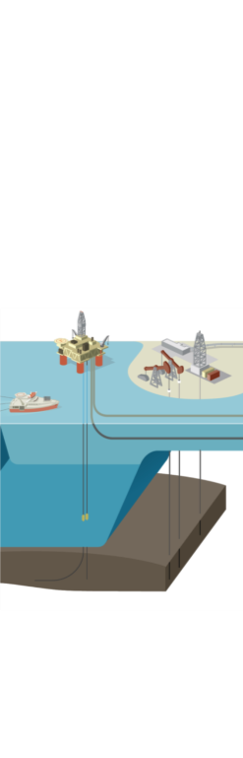

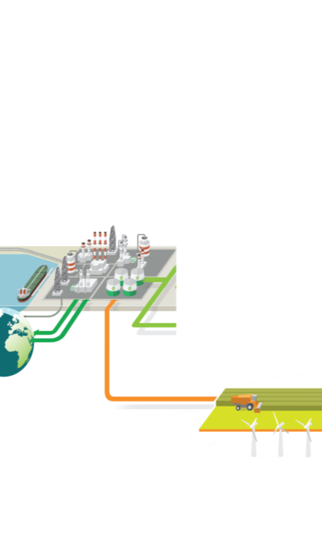


CASTROL: A SPECIALIST
LUBRICANTS BUSINESS AND PART OF BP
BP delivers energy products and services to people around the world.
UPSTREAM
DOWNSTREAM
FINDING
OIL AND GAS
DEVELOPING
AND EXTRACTING
OIL AND GAS
TRANSPORTING
AND TRADING
OIL AND GAS
MANUFACTURING
FUELS AND
PRODUCTS
MARKETING
FUELS AND
PRODUCTS
FUELS, LUBRICANTS
AND PETROCHEMICALS
INTERNATIONAL OIL
AND GAS MARKETS
GENERATING RENEWABLE ENERGY
Notes:
Speaker Notes
Key messages:
Show the entire BP oil process, and where Castrol come in
Show the audience just how much goes on behind the scenes, and build confidence in BP and Castrol
Speech guidance:
Ask a few questions to engage audience:
Did you know Castrol was owned by BP?
When you think of BP, what comes to mind? A petrol station? Filling up your car?
Did you know BP is involved in all stages of oil and gas extraction?
Extra info on the processes:
Through our Upstream and Downstream segments, we find, develop and produce essential sources of energy, turning them into products that people need.
We also buy and sell at each stage of the hydrocarbon value chain.
Our Upstream segment manages exploration, development and production activities.
Our Downstream segment operates hydrocarbon value chains, covering three main businesses – fuels, lubricants and petrochemicals.
We also focus on renewable sources including biofuels and onshore wind.
What does this mean for Castrol? It means that Castrol and its customers benefit from the resources, science and relationships of BP.

Slide 6
OUR TECHNOLOGY AND MANUFACTURING
CENTRES FOR INDUSTRIAL PRODUCTS
PANGBOURNE,
UK
MOENCHENGLADBACH,
GERMANY
LANDAU,
GERMANY
PÉRONNE,
FRANCE
TAICANG,
CHINA
NAPERVILLE,
ILLINOIS
SHANGHAI,
CHINA
WARMINSTER,
PENNSYLVANIA
MUMBAI,
INDIA
MELBOURNE,
AUSTRALIA
Production centres
Technology centre
Notes:
Speaker Notes
Key messages:
Show key areas where Castrol operates around the world
Demonstrate Castrol’s ability to support organisations across the globe
Speech guidance:
Focus on where the customer is currently operating.
If you know the customer is expanding into new markets, reassure them that Castrol will be able to help them in their new markets as well.

Slide 7
THE SITUATION
SECTION 2
THE SITUATION

Slide 8
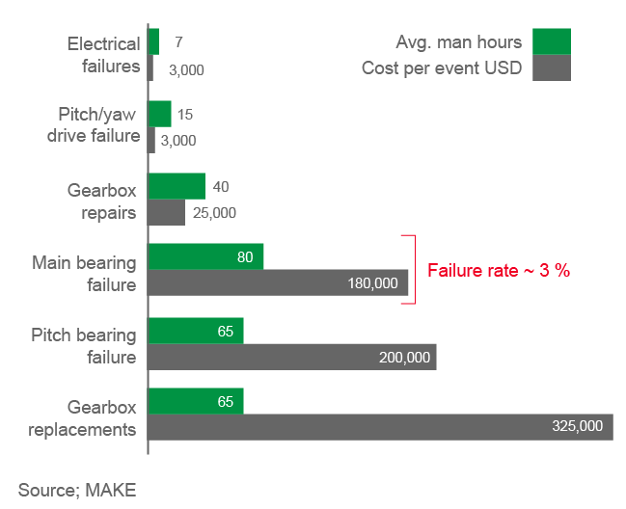
BEARINGs MAINTENANCE COST
PLANNED VS UNPLANNED MAINTENANCE
Semi annual/annual planned maintenance
Cost of component failures (hours/USD):
EVOLUTION | COST | TIME
Grease pitch and yaw bearings | USD 600 per wind turbine generator | 12 man-hours
Grease main bearing
Grease generator bearings

Slide 9




WIND TURBINE BEARINGS:
A UNIQUE CHALLENGE
Sliding and axial loading
Vibration, fretting corrosion and false brinelling
Difficult environmental conditions
Extremely long re-lubrication intervals
Notes:
Growth projections based on the International Energy Agency and Global Wind Energy Council estimates: 6-15% by 2040 and 17-31% by 2050.
LCOE has two main aspects: capital cost repayments and operation & maintenance costs.
24-30% cost reduction based on median expert figure, from current and projected advances in win turbine technology.

Slide 10
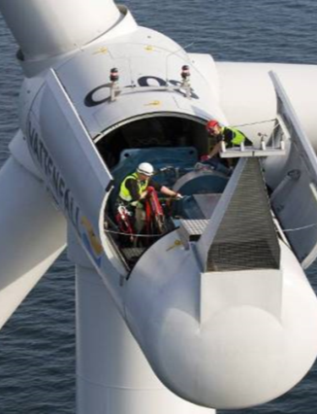
Improved Maintenance
Increases Reliability
Monitor:
You can’t improve what you don’t measure
Improved Maintenance:
Through increased monitoring using grease analysis and CMS
Ensure proper regreasing frequency is followed
Lubricant based options to extend bearing life:
Understand the unique operational challenges
of main bearings
Benchmark current product performance in use
Identify lab tests to correlate to field challenges and performance
Formulate based on grease thickening systems,
base oils and additive interactions / synergies
Higher technology grease with unique surface improving qualities to maximize bearing life

Slide 11
CASTROL’S UNIQUE SOLUTION
SECTION 3
CASTROL‘S UNIQUE SOLUTION

Slide 12
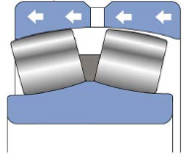
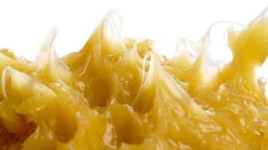
MAIN BEARING GREASE
FORMULATING TO MEET THE CHALLENGES
Downwind
Roller
Upwind
Roller
Wind turbine main bearing grease product profile
Withstands high loads and shock loads (including axial loads)
Resists surface wear and fretting wear
Reduces sliding and rolling wear from axial loading
Low friction for energy saving and long component life
Resists shearing (good mechanical stability)
Resists water ingress
Resists corrosion attack
Good mobility at low temperatures (easy start up)
Controlled bleed rate and oil separation
Axial Loading
Challenge
Multiple test protocols and specifications
Combining all needs for a grease into just one product
Requirements continue to change based on Wind
turbine design

Slide 13


A NEW, LONG-LASTING APPROACH: MICROFLUX
TRANS PLASTIC DEFORMATION TECHNOLOGY*
FROM SACRIFICIAL PROTECTION…
…TO SURFACE MICROSMOOTHING
*MFT-PD Technology = TGOA Technology
Notes:
Speaker notes:
At a microscopic level, even the smoothest metal surface is covered with valleys and peaks. With a traditional lubricant, all the load is carried by a small minority of the surface area – increasing pressure, friction and damage.
MFT (MicroFlux Trans) technology is a way of smoothing out the contact surfaces, increasing the load bearing area and reducing the coefficient of friction. The result is a dramatic reduction in wear – even in parts that have previously experienced damage and micropitting.
Far larger load carrying surface area = Reduced Pressure (thicker lube film)
Far less asperity collisions = Reduced Scuffing (adhesive wear)
Far less subsurface stresses = Reduced Pitting (fatigue wear)

Slide 14



MFT PLASTIC DEFORMATION
TECHNOLOGY*
STAGE
STAGE
STAGE
1
2
3
PROTECTION
COMPRESSION
MICROSMOOTHING
PROTECTIVE LAYER
FORMS IMMEDIATELY
PROTECTIVE
LAYER COMPRESSED,
REDUCING FRICTION
ADDITIVES MIGRATE
INTO METAL SURFACE
*MFT-PD Technology = TGOA Technology

Slide 15

SUMMARY ANIMATION
OF MFT-PD TECHNOLOGY*
WATCH THE VIDEO HERE
*MFT-PD Technology = TGOA Technology

Slide 16


INTRODUCING CASTROL TRIBOL GR SW 460-1
CUSTOM-DESIGNED FOR WIND TURBINES
One grease to meet the multiple challenges faced by wind turbines
Difficult environmental conditions
Extremely long re-lubrication intervals
Failure caused by sliding, axial loading, vibration, fretting corrosion and false brinelling
Multiple test protocols and specifications
Tribol GR SW 460-1 with MFT-PD technology*
Withstands high/shock loads
Resists shearing and wear (fretting, rolling, sliding)
Resists water ingress and corrosion
Good mobility at low temperatures for easy start up
Low friction – improves energy efficiency and prolongs component life
Controlled bleed rate and oil separation
Microflux Trans (MFT) plastic deformation technology*
Sacrificial protection
… to microsmoothing
*MFT-PD Technology = TGOA Technology

Slide 17
LAB TEST RESULTS
SECTION 4
LAB TEST RESULTS

Slide 18
CASTROL TRIBOL GR SW 460-1 WITH MFT-PD TECHNOLOGY*: IDEAL FOR WIND TURBINE USE
LAB TEST RESULTS
PARAMETER | ASTM METHOD | UNIT | TRIBOL GR SW 460-1
THICKENER TYPE |  |  | Lithium complex
COLOR | -- | -- | Yellow
FLUID TYPE | -- | -- | PAO
VISCOSITY @ 40 °C | ASTM D445 | mm²/s | ISO VG 460
VISCOSITY INDEX | ASTM D2270 | -- | 200
PENETRATION, WORKED 60 STROKES | ASTM D217 | mm / 10 | 310 - 340
PENETRATION, WORKED 100,000 STROKES | ASTM D217 | mm / 10 | < 30
DROPPING POINT | ASTM D2265 | C (°F) | > 250 (> 482)
4 BALL WELD | ASTM D2596 | kg | 500
4 BALL WEAR AVERAGE SCAR | ASTM D2266 | mm | 0.4
OIL SEPARATION, RT, 24 HOURS | ASTM D1742 | mass % loss | 3
STEEL CORROSION RESISTANCE | ASTM D6138 | rating | ≤ 0/1
COPPER CORROSION RESISTANCE | ASTM D4048 | rating | 1B
ROLL STABILITY TEST (24 HOURS, 60 °C) | ASTM D1831 | mm / 10 | < 40
WATER WASHOUT @ 79 °C | ASTM D1264 | mass % loss | 5
FLOW PRESSURE @ -40 °C | DIN 51805 | hPa | 500
LOW TEMPERATURE STARTING TORQUE @ -40 °C | ASTM D1478 | Nm | 0.3
LOW TEMPERATURE RUNNING TORQUE @ -40 °C | ASTM D1478 | Nm | 0.07
*MFT-PD Technology = TGOA Technology
Notes:
IN SUMMARY, THIS GREASE DISPLAYS IDEAL PROPERTIES FOR WIND TURBINE BEARING OPERATIONS AND MAINTENANCE:
High shear stability for long life functionality
Excellent bearing wear protection
High load carrying capability
Excellent low temperature start-up and running torque
High water resistance
Very good corrosion resistance (sea water)
Good pumpability at low temperatures
Excellent friction properties - maximizing energy production efficiency
Good Fretting & False Brinelling protection, demonstrated by SRV testing
CURRENT STATUS:
A major wind farm user is already using the grease in the US. Trials are underway in China.

Slide 19
DESIGNED SPECIFICALLY FOR WIND TURBINE USE:
CASTROL TRIBOL GR SW 460-1 TOP IN LAB TESTS
LAB TEST RESULTS
PROPERTY | TEST DESCRIPTION | METHOD | PARAMETER | TRIBOL GR SW 460-1 | GOOD | MEDIUM | POOR
MECHANICAL STABILITY | Roll Stability Test (50 h, 80 °C) | ASTM D1831 mod | PW 60 unit change | < 10 % | < 15 % | 15 - 20 % | > 20 %
CORROSION RESISTANCE | Emcor Test 1 % NaCl | DIN 51802 |  | ≤ 0 / 1 | ≤ 0 / 1 | 1 / 1 – 1 / 2 | > 1 / 2
LOW TEMPERATURE | Flow Pressure at -40 °C | DIN 51805 |  | 525 hPa | ≤ 800 hPa | 825 - 1400 hPa | > 1400 hPa
 | Low Temp Torque at -40 °C | ASTM D1478 | Start Torque (ST) / Running Torque (RT) | 0.3 Nm / 0.07 Nm | < 0.5 Nm / < 0.1 Nm | 0.5-1.0 Nm / 0.1-0.5 Nm | > 1.0 Nm / > 0.5 Nm
FE8 – WEAR | FE8 C/75/50 | DIN 51819-2 | Wear MW50 | 1.5 mg | < 10 mg | 10 - 50 mg | > 50 mg
FE8 – TEMP/TORQUE | FE8 C/75/50 | DIN 51819-2 | Temperature max ST / RT | < 50 °C 12 Nm / 5.5 Nm | < 60 °C <15 Nm / <8 Nm | 60 - 90 °C 15 -30 Nm / 8 - 15 Nm | > 90 °C > 30 Nm / > 15 Nm
FAFNIR – ASTM D4170 |  | ASTM D4170 | Wear loss | < 10 mg | < 10 mg | 10– 20 mg | > 20 mg
SRV – ASTM D7594 |  | ASTM D7594 | COF Friction curve | Low, stable Smooth, no fretting | Low, stable Smooth, no fretting | Medium, stable Smooth, no fretting | High, unstable Rocky, fretting
SRV – ASTM D7594 at 0 °C |  |  | COF Friction curve | Stable, no fretting | Stable, no fretting |  | Rocky, fretting
Notes:
Speaker notes:
At a microscopic level, even the smoothest metal surface is covered with valleys and peaks. With a traditional lubricant, all the load is carried by a small minority of the surface area – increasing pressure, friction and damage.
MFT (MicroFlux Trans) technology is a way of smoothing out the contact surfaces, increasing the load bearing area and reducing the coefficient of friction. The result is a dramatic reduction in wear – even in parts that have previously experienced damage and micropitting.
Far larger load carrying surface area = Reduced Pressure (thicker lube film)
Far less asperity collisions = Reduced Scuffing (adhesive wear)
Far less subsurface stresses = Reduced Pitting (fatigue wear)

Slide 20
DESIGNED SPECIFICALLY FOR WIND TURBINE USE:
CASTROL TRIBOL GR SW 460-1 TOP IN LAB TESTS
PROPERTY | TRIBOL GR SW 460-1 | COMPETITOR A | COMPETITOR B | COMPETITOR C | COMPETITOR D | COMPETITOR E
MECHANICAL STABILITY
CORROSION RESISTANCE
LOW TEMPERATURE
FE8 – WEAR
FE8 – TEMP/TORQUE
FAFNIR – ASTM D4170
SRV – ASTM D7594
SRV – ASTM D7594 at 0 °C
RELATIVE PERFORMANCE RATING
GOOD | MEDIUM | POOR
Notes:
Speaker notes:
At a microscopic level, even the smoothest metal surface is covered with valleys and peaks. With a traditional lubricant, all the load is carried by a small minority of the surface area – increasing pressure, friction and damage.
MFT (MicroFlux Trans) technology is a way of smoothing out the contact surfaces, increasing the load bearing area and reducing the coefficient of friction. The result is a dramatic reduction in wear – even in parts that have previously experienced damage and micropitting.
Far larger load carrying surface area = Reduced Pressure (thicker lube film)
Far less asperity collisions = Reduced Scuffing (adhesive wear)
Far less subsurface stresses = Reduced Pitting (fatigue wear)

Slide 21
PLEASE CONTACT:

