Slide 1
TECHNICAL PRESENTATION
TRIBOL GR SW 460-1 WIND TURBINE GREASE
Name
1.1.2020

Slide 2
CONTENTS
1
WHO WE ARE
4
LAB TEST RESULTS
Castrol & BP
Our heritage
Wind turbine readiness and testing
5
SUCCESSFUL CASES IN FIELD
2
THE SITUATION
Bearings maintenance cost
Wind turbine bearings
Improved maintenance increases reliability
Proven in field
6
CHANGEOVER PROCEDURE (GREASE)
Grease compatibility
Procedure
Grease sampling
3
CASTROL’S UNIQUE SOLUTION
MFT Plastic Deformation Technology
Main bearing grease

Slide 3
WHO WE ARE
SECTION 1
WHO WE ARE

Slide 4


WHO WE ARE – CASTROL & BP
BP
BP is one of the world’s leading international oil and gas companies
We employ over 74,500 people
We have operations on 6 continents and in over 80 countries
CASTROL
Castrol (BP Lubricants) was founded in 1899 by Charles Cheers Wakefield
We operate directly in over 46 countries
We market our products to over half a million customers in 120 countries
We employ 7,500 people worldwide
Notes:
Speaker Notes
Key messages:
Offer a top-level view of both BP and Castrol
Show that both organizations are major players the audience can trust
Speech guidance:
Focus on how both organizations operate worldwide
Wherever you operate, Castrol and BP have the ideal solution for you
Use examples to bring the number of employees to life:
BP employs enough people to fill the entire Principality Stadium in Cardiff

Slide 5

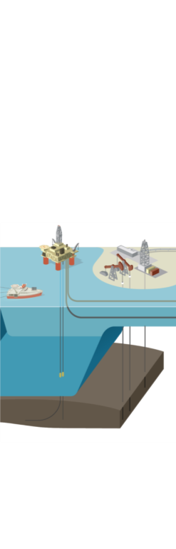




CASTROL: A SPECIALIST LUBRICANTS BUSINESS AND PART OF BP
BP delivers energy products and services to people around the world.
UPSTREAM
DOWNSTREAM
FINDING
OIL AND GAS
DEVELOPING
AND EXTRACTING
OIL AND GAS
TRANSPORTING
AND TRADING
OIL AND GAS
MANUFACTURING
FUELS AND PRODUCTS
MARKETING
FUELS AND
PRODUCTS
FUELS, LUBRICANTS AND PETROCHEMICALS
INTERNATIONAL OIL
AND GAS MARKETS
GENERATING RENEWABLE ENERGY
Notes:
Speaker Notes
Key messages:
Show the entire BP oil process, and where Castrol come in
Show the audience just how much goes on behind the scenes, and build confidence in BP and Castrol
Speech guidance:
Ask a few questions to engage audience:
Did you know Castrol was owned by BP?
When you think of BP, what comes to mind? A petrol station? Filling up your car?
Did you know BP is involved in all stages of oil and gas extraction?
Extra info on the processes:
Through our Upstream and Downstream segments, we find, develop and produce essential sources of energy, turning them into products that people need.
We also buy and sell at each stage of the hydrocarbon value chain.
Our Upstream segment manages exploration, development and production activities.
Our Downstream segment operates hydrocarbon value chains, covering three main businesses – fuels, lubricants and petrochemicals.
We also focus on renewable sources including biofuels and onshore wind.
What does this mean for Castrol? It means that Castrol and its customers benefit from the resources, science and relationships of BP.

Slide 6
OUR TECHNOLOGY AND MANUFACTURING CENTRES FOR INDUSTRIAL PRODUCTS
PANGBOURNE, UK
MOENCHENGLADBACH, GERMANY
LANDAU, GERMANY
PÉRONNE, FRANCE
TAICANG, CHINA
NAPERVILLE, ILLINOIS
SHANGHAI, CHINA
WARMINSTER, PENNSYLVANIA
MUMBAI, INDIA
MELBOURNE, AUSTRALIA
Production centres
Technology centre
Notes:
Speaker Notes
Key messages:
Show key areas where Castrol operates around the world
Demonstrate Castrol’s ability to support organisations across the globe
Speech guidance:
Focus on where the customer is currently operating.
If you know the customer is expanding into new markets, reassure them that Castrol will be able to help them in their new markets as well.

Slide 7
THE SITUATION
SECTION 2
THE SITUATION

Slide 8
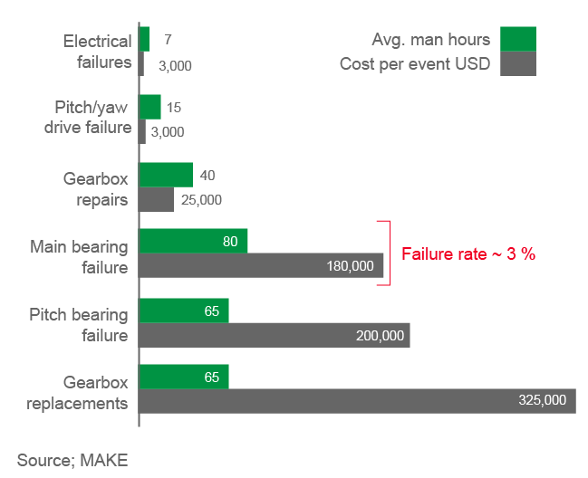
BEARINGs MAINTENANCE COST PLANNED VS UNPLANNED MAINTENANCE
Semi annual/annual planned maintenance
Cost of component failures (hours/USD):
EVOLUTION | COST | TIME
Grease pitch and yaw bearings | USD 600 per wind turbine generator | 12 man-hours
Grease main bearing
Grease generator bearings

Slide 9




WIND TURBINE BEARINGS: A UNIQUE CHALLENGE
Sliding and axial loading
Vibration, fretting corrosion and false brinelling
Difficult environmental conditions
Extremely long re-lubrication intervals
Notes:
Growth projections based on the International Energy Agency and Global Wind Energy Council estimates: 6-15% by 2040 and 17-31% by 2050.
LCOE has two main aspects: capital cost repayments and operation & maintenance costs.
24-30% cost reduction based on median expert figure, from current and projected advances in win turbine technology.

Slide 10
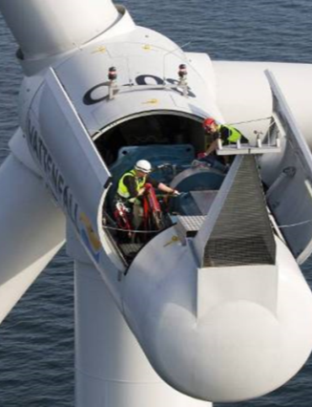
Improved Maintenance Increases Reliability
Monitor:
You can’t improve what you don’t measure
Improved Maintenance:
Through increased monitoring using grease analysis and CMS
Ensure proper regreasing frequency is followed
Lubricant based options to extend bearing life:
Understand the unique operational challenges of main bearings
Benchmark current product performance in use
Identify lab tests to correlate to field challenges and performance
Formulate based on grease thickening systems, base oils and additive interactions / synergies
Higher technology grease with unique surface improving qualities to maximise bearing life

Slide 11
CASTROL’S UNIQUE SOLUTION
SECTION 3
CASTROL‘S UNIQUE SOLUTION

Slide 12
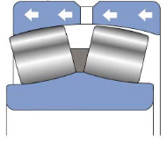
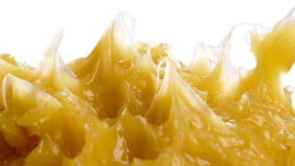
MAIN BEARING GREASE FORMULATING TO MEET THE CHALLENGES
Downwind
Roller
Upwind
Roller
Wind turbine main bearing grease product profile
Withstands high loads and shock loads (including axial loads)
Resists surface wear and fretting wear
Reduces sliding and rolling wear from axial loading
Low friction for energy saving and long component life
Resists shearing (good mechanical stability)
Resists water ingress
Resists corrosion attack
Good mobility at low temperatures (easy start up)
Controlled bleed rate and oil separation
Axial Loading
Challenge
Multiple test protocols and specifications
Combining all needs for a grease into just one product
Requirements continue to change based on Wind turbine design

Slide 13


A NEW, LONG-LASTING APPROACH: MICROFLUX TRANS PLASTIC DEFORMATION TECHNOLOGY*
FROM SACRIFICIAL PROTECTION…
…TO SURFACE MICROSMOOTHING
*MFT-PD Technology = TGOA Technology
Notes:
Speaker notes: At a microscopic level, even the smoothest metal surface is covered with valleys and peaks. With a traditional lubricant, all the load is carried by a small minority of the surface area – increasing pressure, friction and damage. MFT (MicroFlux Trans) technology is a way of smoothing out the contact surfaces, increasing the load bearing area and reducing the coefficient of friction. The result is a dramatic reduction in wear – even in parts that have previously experienced damage and micropitting.
Far larger load carrying surface area = Reduced Pressure (thicker lube film)
Far less asperity collisions = Reduced Scuffing (adhesive wear)
Far less subsurface stresses = Reduced Pitting (fatigue wear)

Slide 14



MFT PLASTIC DEFORMATION TECHNOLOGY*
STAGE
STAGE
STAGE
1
2
3
PROTECTION
COMPRESSION
MICROSMOOTHING
PROTECTIVE LAYER FORMS IMMEDIATELY
PROTECTIVE LAYER COMPRESSED, REDUCING FRICTION
ADDITIVES MIGRATE INTO METAL SURFACE
*MFT-PD Technology = TGOA Technology

Slide 15

SUMMARY ANIMATION OF MFT-PD TECHNOLOGY*
WATCH THE VIDEO HERE
*MFT-PD Technology = TGOA Technology

Slide 16


INTRODUCING CASTROL TRIBOL GR SW 460-1 CUSTOM-DESIGNED FOR WIND TURBINES
One grease to meet the multiple challenges faced by wind turbines
Difficult environmental conditions
Extremely long re-lubrication intervals
Failure caused by sliding, axial loading, vibration, fretting corrosion and false brinelling
Multiple test protocols and specifications
Tribol GR SW 460-1 with MFT-PD technology*
Withstands high/shock loads
Resists shearing and wear (fretting, rolling, sliding)
Resists water ingress and corrosion
Good mobility at low temperatures for easy start up
Low friction – improves energy efficiency and prolongs component life
Controlled bleed rate and oil separation
Microflux Trans (MFT) plastic deformation technology*
Sacrificial protection
… to microsmoothing
*MFT-PD Technology = TGOA Technology

Slide 17
LAB TEST RESULTS
SECTION 4
LAB TEST RESULTS

Slide 18
DESIGNED SPECIFICALLY FOR WIND TURBINE USE: CASTROL TRIBOL GR SW 460-1 TOP IN LAB TESTS
LAB TEST RESULTS
PROPERTY | TEST DESCRIPTION | METHOD | PARAMETER | TRIBOL GR SW 460-1 | GOOD | MEDIUM | POOR
MECHANICAL STABILITY | Roll Stability Test (50 h, 80 °C) | ASTM D1831 mod | PW 60 unit change | < 10 % | < 15 % | 15 - 20 % | > 20 %
CORROSION RESISTANCE | Emcor Test 1 % NaCl | DIN 51802 |  | ≤ 0 / 1 | ≤ 0 / 1 | 1 / 1 – 1 / 2 | > 1 / 2
LOW TEMPERATURE | Flow Pressure at -40 °C | DIN 51805 |  | 525 hPa | ≤ 800 hPa | 825 - 1400 hPa | > 1400 hPa
 | Low Temp Torque at -40 °C | ASTM D1478 | Start Torque (ST) / Running Torque (RT) | 0.3 Nm / 0.07 Nm | < 0.5 Nm / < 0.1 Nm | 0.5-1.0 Nm / 0.1-0.5 Nm | > 1.0 Nm / > 0.5 Nm
FE8 – WEAR | FE8 C/75/50 | DIN 51819-2 | Wear MW50 | 1.5 mg | < 10 mg | 10 - 50 mg | > 50 mg
FE8 – TEMP/TORQUE | FE8 C/75/50 | DIN 51819-2 | Temperature max ST / RT | < 50 °C 12 Nm / 5.5 Nm | < 60 °C <15 Nm / <8 Nm | 60 - 90 °C 15 -30 Nm / 8 - 15 Nm | > 90 °C > 30 Nm / > 15 Nm
FAFNIR – ASTM D4170 |  | ASTM D4170 | Wear loss | < 10 mg | < 10 mg | 10– 20 mg | > 20 mg
SRV – ASTM D7594 |  | ASTM D7594 | COF Friction curve | Low, stable Smooth, no fretting | Low, stable Smooth, no fretting | Medium, stable Smooth, no fretting | High, unstable Rocky, fretting
SRV – ASTM D7594 at 0 °C |  | ASTM D7594 | COF Friction curve | Stable, no fretting | Stable, no fretting | N/A | Rocky, fretting
Notes:
Speaker notes: At a microscopic level, even the smoothest metal surface is covered with valleys and peaks. With a traditional lubricant, all the load is carried by a small minority of the surface area – increasing pressure, friction and damage. MFT (MicroFlux Trans) technology is a way of smoothing out the contact surfaces, increasing the load bearing area and reducing the coefficient of friction. The result is a dramatic reduction in wear – even in parts that have previously experienced damage and micropitting.
Far larger load carrying surface area = Reduced Pressure (thicker lube film)
Far less asperity collisions = Reduced Scuffing (adhesive wear)
Far less subsurface stresses = Reduced Pitting (fatigue wear)

Slide 19
DESIGNED SPECIFICALLY FOR WIND TURBINE USE: CASTROL TRIBOL GR SW 460-1 TOP IN LAB TESTS
PROPERTY | TRIBOL GR SW 460-1 | COMPETITOR A | COMPETITOR B | COMPETITOR C | COMPETITOR D | COMPETITOR E
MECHANICAL STABILITY
CORROSION RESISTANCE
LOW TEMPERATURE
FE8 – WEAR
FE8 – TEMP/TORQUE
FAFNIR – ASTM D4170
SRV – ASTM D7594
SRV – ASTM D7594 at 0 °C
RELATIVE PERFORMANCE RATING
GOOD | MEDIUM | POOR
Notes:
Speaker notes: At a microscopic level, even the smoothest metal surface is covered with valleys and peaks. With a traditional lubricant, all the load is carried by a small minority of the surface area – increasing pressure, friction and damage. MFT (MicroFlux Trans) technology is a way of smoothing out the contact surfaces, increasing the load bearing area and reducing the coefficient of friction. The result is a dramatic reduction in wear – even in parts that have previously experienced damage and micropitting.
Far larger load carrying surface area = Reduced Pressure (thicker lube film)
Far less asperity collisions = Reduced Scuffing (adhesive wear)
Far less subsurface stresses = Reduced Pitting (fatigue wear)

Slide 20
CASTROL TRIBOL GR SW 460-1 WITH MFT-PD TECHNOLOGY*: IDEAL FOR WIND TURBINE USE
LAB TEST RESULTS
PARAMETER | ASTM METHOD | UNIT | TRIBOL GR SW 460-1
THICKENER TYPE |  |  | Lithium complex
COLOR | -- | -- | Yellow
FLUID TYPE | -- | -- | PAO
VISCOSITY @ 40 °C | ASTM D445 | mm²/s | ISO VG 460
VISCOSITY INDEX | ASTM D2270 | -- | 200
PENETRATION, WORKED 60 STROKES | ASTM D217 | mm / 10 | 310 - 340
PENETRATION, WORKED 100,000 STROKES | ASTM D217 | mm / 10 | < 30
DROPPING POINT | ASTM D2265 | C (°F) | > 250 (> 482)
4 BALL WELD | ASTM D2596 | kg | 500
4 BALL WEAR AVERAGE SCAR | ASTM D2266 | mm | 0.4
OIL SEPARATION, RT, 24 HOURS | ASTM D1742 | mass % loss | 3
STEEL CORROSION RESISTANCE | ASTM D6138 | rating | ≤ 0/1
COPPER CORROSION RESISTANCE | ASTM D4048 | rating | 1B
ROLL STABILITY TEST (24 HOURS, 60 °C) | ASTM D1831 | mm / 10 | < 40
WATER WASHOUT @ 79 °C | ASTM D1264 | mass % loss | 5
FLOW PRESSURE @ -40 °C | DIN 51805 | hPa | 500
LOW TEMPERATURE STARTING TORQUE @ -40 °C | ASTM D1478 | Nm | 0.3
LOW TEMPERATURE RUNNING TORQUE @ -40 °C | ASTM D1478 | Nm | 0.07
*MFT-PD Technology = TGOA Technology
Notes:
IN SUMMARY, THIS GREASE DISPLAYS IDEAL PROPERTIES FOR WIND TURBINE BEARING OPERATIONS AND MAINTENANCE: High shear stability for long life functionality
Excellent bearing wear protection
High load carrying capability
Excellent low temperature start-up and running torque
High water resistance
Very good corrosion resistance (sea water)
Good pumpability at low temperatures
Excellent friction properties - maximizing energy production efficiency
Good Fretting & False Brinelling protection, demonstrated by SRV testing
CURRENT STATUS: A major wind farm user is already using the grease in the US. Trials are underway in China.

Slide 21
DESIGNED SPECIFICALLY FOR WIND TURBINE USE: CASTROL TRIBOL GR SW 460-1 TOP IN LAB TESTS
LAB TEST RESULTS
PROPERTY | TEST DESCRIPTION | METHOD | SLIDES
MECHANICAL STABILITY | Roll Stability, 50 h, 80 °C | ASTM D1831 | 22
CORROSION RESISTANCE | Emcor Rust Test, RT, 7 days | ASTM D6138 | 23
LOAD CARRYING CAPACITY | Four ball EP Weld / Wear | ASTM D2596 / 2266 | 24
LOW TEMPERATURE PROPERTIES | Flow Pressure & Low Temperature Torque | DIN 51805 ASTM D1478 | 25
PROTECTION AGAINST WEAR & ENERGY EFFICIENCY | FE8 Rig Test | DIN 51819 - 2 (mod) | 26 - 27
RESISTANCE TO FRETTING WEAR | Fafnir Fretting Test SRV-Fretting Test | ASTM D4170 ASTM D7594 | 28 - 29
RESISTANCE TO FRETTING WEAR UNDER LOW TEMPERATURES | SRV-Fretting Test | ASTM D7594 | 30
PROTECTION AGAINST RIPPLE & CORROSION | IME-Ripple Rig Test |  | 31
HIGH TEMPERATURE PROPERTIES | FE9 Rig Test | DIN 51821-2 | 32
Notes:
This slide can be inserted instead of the previous one if customers are interested in Ripple Test Data and High Temperature Application (FE-9 for China). Otherwise the slide will remain hidden

Slide 22
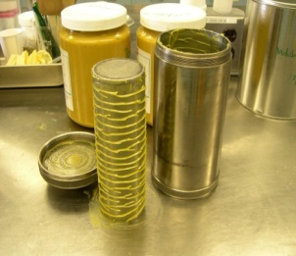
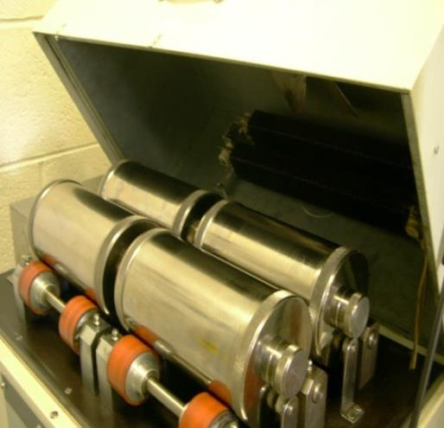
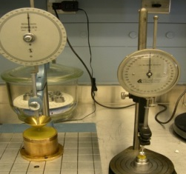
MECHANICAL STABILITY: ROLL STABILITY TEST
ROLL STABILITY TEST – modified ASTM D1831:
Measurement of the effect of low shear working on grease:
Place grease (50 g) into cylinder (185 mm x 90 mm)
Insert rolling weight (5 kg; 175 mm x 60 mm) into cylinder
Determine difference in consistency before and after low shear stress
Rolling speed = 165 rpm
Temperature = 80 °C
Duration = 50 h
A
C
D
B
DIMENSIONS
A | 60 mm
B | 175 mm
C | 90 mm
D | 185 mm
PRODUCT | Δ PW 60 [mm/10]
Tribol GR SW 460-1 | < 30 (< 10 %)
Tribol GR SW 460-1 is very shear stable under mechanical stress. The modified ASTM D1831 roll stability test at 80 °C for 50 hours is a very severe test. None of the tested competitors had less than 15 % loss of consistency.
Notes:
Tribol GR SW 460-1 is highly shear stable under mechanical stress;
Roll stability test at 80 °C for 50 h is a very severe test;
Performance excellent; extremely shear stable
None of the tested competitor product had less than 15%

Slide 23
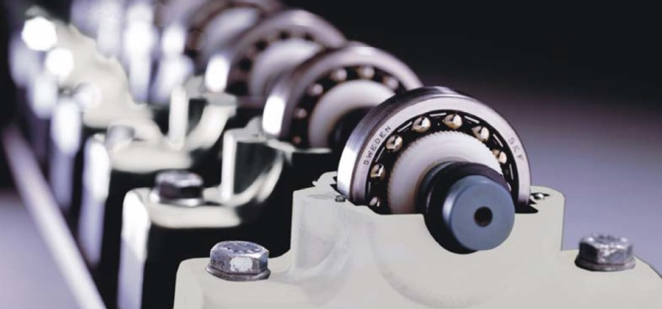
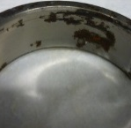
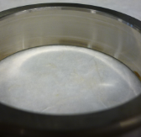
CORROSION PREVENTIVE PROPERTIES
Emcor TEST – ASTM D6138:
Fill ball bearing with grease and mount on shaft
Add test solution, e.g. 1 % NaCl solution (20 mL/bearing)
Test cycle: 8 h run – 16 h stop – 8 h run – 16 h stop – 8 h run – 108 h stop
Evaluation of outer ring for corrosion after test cycle
Temperature = RT; duration = 168 h; speed = 80 rpm
PRODUCT | Emcor – 1 % NaCl
Tribol GR SW 460-1 | ≤ 0 / 1
Tribol GR SW 460-1 provides excellent protection against corrosion.
The Emcor Test was run under severe conditions (1 % NaCl) and still the product achieved the best result possible; hence it is suitable for offshore applications.
Notes:
Tribol GR SW 460-1 has excellent corrosion protection on steel:
Severe conditions with 1% NaCl and still the product provides the best protection
Product suitable for offshore conditions

Slide 24
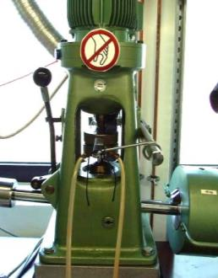
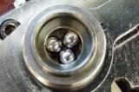
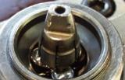
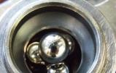
PROTECTION AGAINST WEAR & WELD: 4 BALL APPARATUS LOAD CARRYING PROPERTIES
PRODUCT | WELD LOAD [kgf] ASTM D2596 | WEAR SCAR DIAMETER [mm] ASTM D2266
Tribol GR SW 460-1 | 500 | 0.4
A grease with a weld load above 400 kgf and a wear scar diameter below 0.5 mm is considered a lubricant with high load carrying capacity and suitable for heavy duty applications.
High Performance Tribol GR SW 460-1 exceeds these specifications.
Notes:
Speaker notes: At a microscopic level, even the smoothest metal surface is covered with valleys and peaks. With a traditional lubricant, all the load is carried by a small minority of the surface area – increasing pressure, friction and damage. MFT (MicroFlux Trans) technology is a way of smoothing out the contact surfaces, increasing the load bearing area and reducing the coefficient of friction. The result is a dramatic reduction in wear – even in parts that have previously experienced damage and micropitting.
Far larger load carrying surface area = Reduced Pressure (thicker lube film)
Far less asperity collisions = Reduced Scuffing (adhesive wear)
Far less subsurface stresses = Reduced Pitting (fatigue wear)

Slide 25
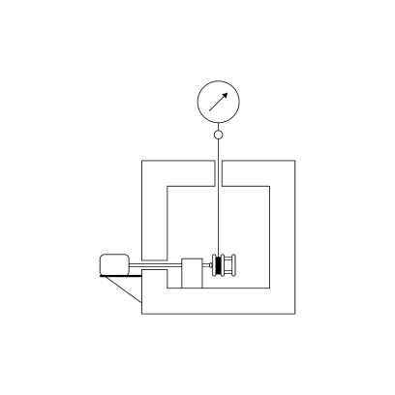
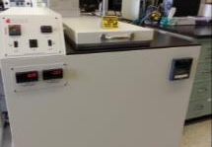

FLOW PRESSURE: DIN 51805 DETERMINATION OF FLOW PRESSURE OF GREASES LOW TEMPERATURE EFFECTIVENESS: ASTM D1478 BEARING ROTATION BELOW -20 °C
LAB TEST RESULTS
Tribol GR SW 460-1 has excellent low temperature performance; Competitor products with the same base oil ISO VG class have significantly higher flow pressure and low temperature torque results by ~ 50 %.
Minimise internal grease drag or wasted energy at low start-up temperature
CONNECTING CORD
DYNAMOMETER SCALE
COLD BOX
TEST CAGE
Tested the product @ -40 °C | FLOW PRESSURE [hPa] | LOW TEMPERATURE TORQUE
 |  | START TORQUE [Nm] | RUNNING TORQUE [Nm]
Tribol GR SW 460-1 | 525 | 0.3 | 0.07
GEAR REDUCTER
1 r/min Output
DRIVE MOTOR
¼ hp (187 W)
Notes:
S-214-16: 350 hPa/ S-215-16: 525 hPa
Tribol GR SW 460-1 has excellent low temperature performance, due to use of High viscosity index base oils
Very low flow pressure combined with very low start-up and running torque at -40 °C
Allows product to be used in cold temperature areas; benefits with pumpability
Test details: Flow Pressure - DIN 51805: Determination of flow pressure of greases
Low Temperature Torque of Ball Bearing Grease – ASTM D1478-11:
Determination of retardation of rotation of a slow-speed ball bearing caused by a grease at low temperature below -20 °C
Bearing type: No. 6204 ▪ Rotation speed: 1 rpm
Measurement after 2 h incubation at low temperature of starting torque (maximum torque) and running torque (after 60 min)
Temperature range: -75 °C to -20 °C

Slide 26

PROTECTION AND ENERGY EFFICIENCY: STEADY STATE TEMPERATURE AND FRICTION TORQUE – FE8 TEST – DIN 51819-2
LAB TEST RESULTS
 | TRIBOL GR SW 460-1
ROLLERS (MW50) | 1.5 mg
CAGE (MK50) | 18 mg
STARTING TORQUE | 12 Nm
RUNNING TORQUE | 5.5 Nm
FE8 test DIN 51819-2: C/75/50
Tappered roller bearing 31312
Temperature = RT, no cooling
Duration = 500 hours
Speed = 75 rpm
Axial load = 50 kN
One of the global bearing manufacturers specifies 35 mg as the maximum value for wear on rollers
Tribol GR SW 460-1 exceeds this requirement by far
Tribol GR SW 460-1 runs at lower temperature and with lower torque than the tested competitor products, showing potential for energy savings
Notes:
FE8 test is a wear test; axial load is applied, 2 bearings are tested per run, and after the run on both bearings are measured for wear on rollers, cage and inner and outer ring.
Tribol GR SW 460-1 shows low wear on the rollers
Friction torque is low and also the temperature of the run is low indicating benefits re energy efficiency Test details: FE8 TEST - DIN 51819-2: Mechanical-dynamic testing in roller bearing test apparatus FE8
Fill two tappered roller bearing 31312 with 200 mL grease/ bearing
Mount on roller bearing test apparatus
Temperature = RT, no cooling
Duration = 500 h
Speed = 75 rpm
Axial load = 50 kN

Slide 27
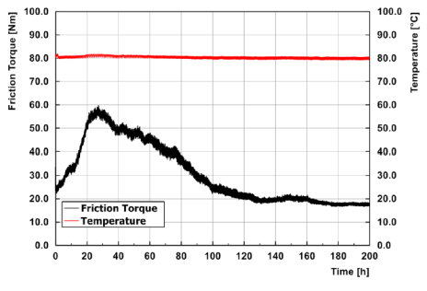
PROTECTION AGAINST WEAR AT LOW SPEED AND HIGH LOADS: MODIFIED FE8 TEST
 | TRIBOL GR SW 460-1
ROLLERS (MW50) | 2 mg
CAGE (MK50) | 16 mg
STARTING TORQUE | 60 Nm
RUNNING TORQUE | 18 Nm
Criteria of this test for very good anti-wear performance is less than 10 mg wear on all rolling elements
Tribol GR SW 460-1 provides excellent wear protection with only 2 mg wear on all rolling elements
MODIFIED FE8 TEST WITH SPHERICAL ROLLER BEARINGS SKF 29412-E:
Temperature = 80 °C
Duration = 200 hours
Speed = 7.5 rpm
Axial load = 127 kN
Notes:
FE8 test is a wear test; axial load is applied, 2 bearings are tested per run, and after the run on both bearings are measured for wear on rollers, cage and inner and outer ring.
Tribol GR SW 460-1 shows low wear on the rollers
Friction torque is low and also the temperature of the run is low indicating benefits re energy efficiency Test details: FE8 TEST - DIN 51819-2: Mechanical-dynamic testing in roller bearing test apparatus FE8
Fill two tappered roller bearing 31312 with 200 mL grease/ bearing
Mount on roller bearing test apparatus
Temperature = RT, no cooling
Duration = 500 h
Speed = 75 rpm
Axial load = 50 kN

Slide 28
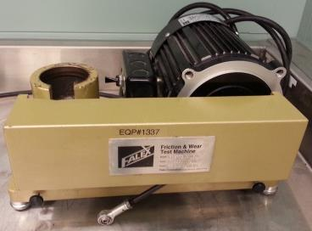
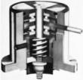
PROTECTION AGAINST FALSE BRINELLING: FAFNIR TEST – ASTM D4170
CONDITIONS Bearing: Thrust bearing
Load: 2.45 kN
Test duration: 22 hours
Frequency: 30 Hz
Amplitude: +/- 6 °
Measurement: Weight loss, optical investigation
PRODUCT | WEAR LOSS [mg]
TRIBOL GR SW 460-1 | 6.4
The Fafnir test is used to determine the ability of grease to protect against false brinelling damage. Tribol GR SW 460-1 achieves low wear loss results. Wear results below 10 mg indicate good fretting wear protection.

Slide 29
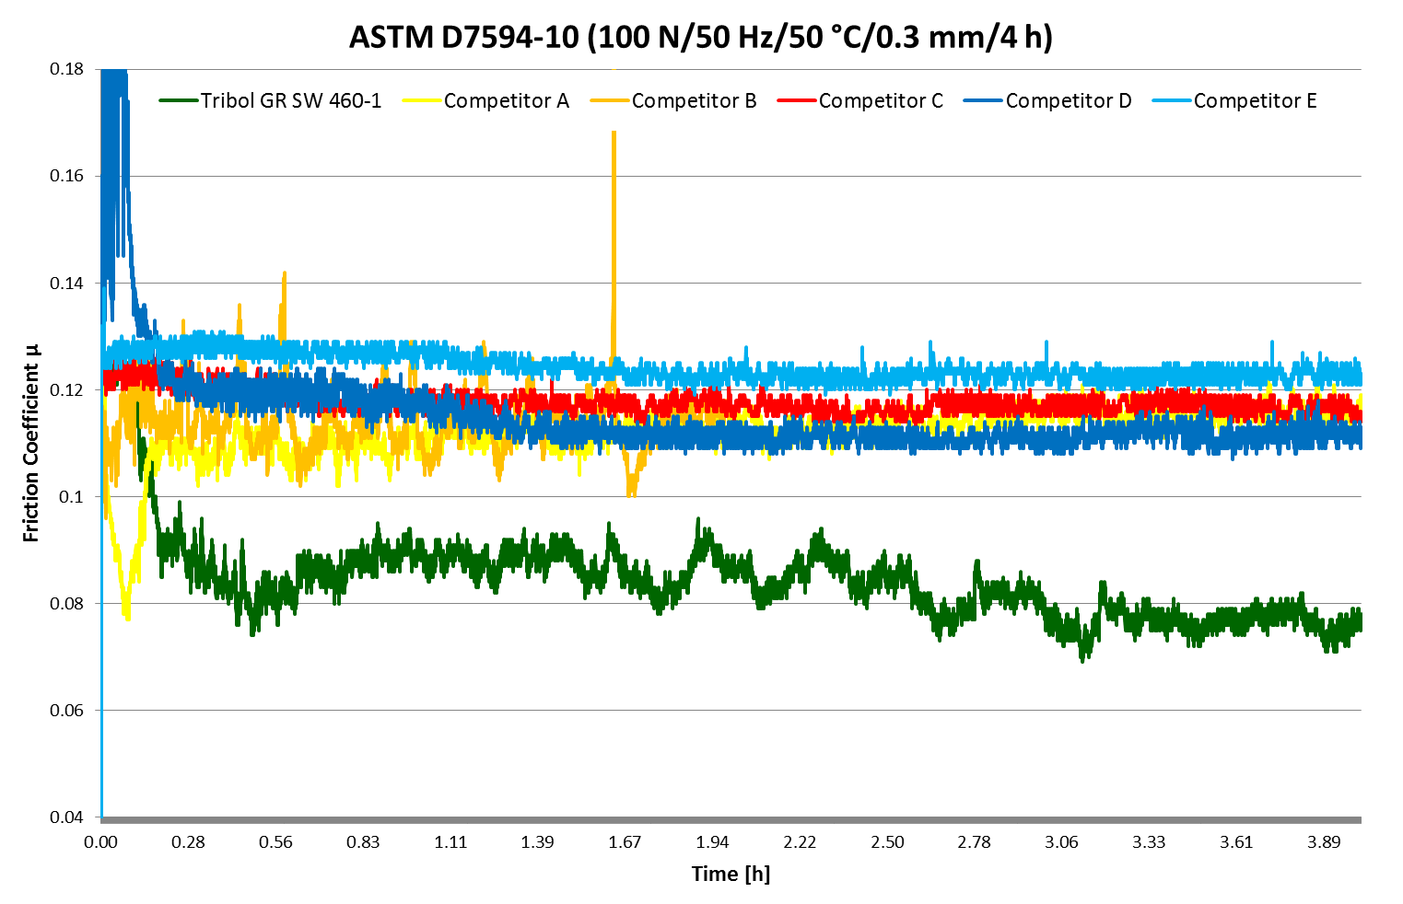

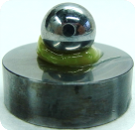

PROTECTION AGAINST FALSE BRINELLING: SRV FRETTING TEST – ASTM D7594
ASTM D7594 FRETTING WEAR at 50 °C | WEAR SCAR DIAMTER [mm]
TRIBOL GR SW 460-1 | 0.35
COMPETITOR A | 0.40
COMPETITOR B | 0.73
COMPETITOR C | 0.41
COMPETITOR D | 0.50
COMPETITOR E | 0.40
A low coefficient of friction correlates to low friction in the application potentially offering energy benefits; a low wear scar diameter indicates good wear protection. Tribol GR SW 460-1 offers the lowest coefficient of friction compared to the competitor products and has the smallest wear scar diameter.
Notes:
False brinelling protection tested with SRV at 50°C
Very low friction for Tribol GR SW 460-1 – with lower wear than all competitors.
Test details:
SRV – Fretting Test ASTM 7594-10 (100 N50 Hz50 °C0.3 mm4 h)

Slide 30
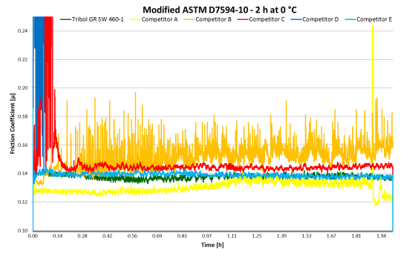
PROTECTION AGAINST FALSE BRINELLING AT LOW TEMPERATURE: SRV FRETTING TEST - ASTM 7594 at 0 °C
ASTM D7594 FRETTING WEAR at 0 °C | WEAR SCAR DIAMETER [mm]
TRIBOL GR SW 460-1 | 0.33 (4 hours)
COMPETITOR A | 0.33
COMPETITOR B | 0.36
COMPETITOR C | 0.54
COMPETITOR D | –
COMPETITOR E | 0.38
Protection against Fretting wear is even more relevant at lower temperature. ASTM D7594 was modified to run at 0 °C. Tribol GR SW 460-1 has a stable coefficient of friction, providing a low wear scar diameter, that indicates good protection against fretting wear at lower temperatures.
Notes:
False brinelling protection tested with SRV at 50°C
Very low friction for Tribol GR SW 460-1 – with lower wear than all competitors.
Test details:
SRV – Fretting Test ASTM 7594-10 (100 N50 Hz50 °C0.3 mm4 h)

Slide 31
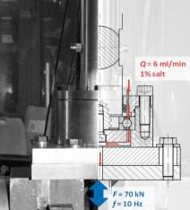

PROTECTION AGAINST FALSE BRINELLING: RIPPLE & CORROSION PROTECTION PROPERTY TEST AT IME AACHEN
Internal reference
CONDITIONS Bearing: Four point contact ball bearing (FAG QJ212.TVP)
Load: 70 kN
Test duration: 28 hours (1 mio cycles)
Frequency: 10 Hz
Contamination: 1 % NaCl at 6 mL / min
Measurement: maximum ripple depth, average ripple depth, corrosion grade
Limits: RD-max ≤ 10 µm RD-av ≤ 3 µm Corrosion grade ≤ 2
PRODUCT | RIPPLE DEPTH – MAX [µm] | RIPPLE DEPTH – AV [µm] | CORROSION GRADE
TRIBOL GR SW 460-1 | 8.5 | 2.96 | 1.5
The ripple corrosion test is used to determine the ability of grease to protect against false brinelling damage.
Tribol GR SW 460-1 passes the test with 1 % NaCl contamination.

Slide 32
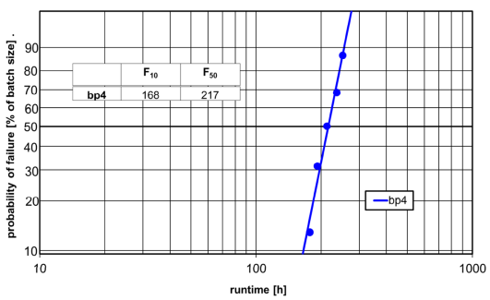

HIGH TEMPERATURE PERFORMANCE: DEFINING MAXIMUM OPERATING TEMPERATURE – FE9 TEST-DIN 51821-2
Internal reference
TRIBOL GR SW 460-1 | TIME [hours]
BEARING 1 | 177
BEARING 2 | 251
BEARING 3 | 212
BEARING 4 | 236
BEARING 5 | 192
F50 | 217
Pass criteria for FE9 tests is a F50 value higher than 100 hours. F50 value of Tribol GR SW 460-1 is 217 hours, over 50 % more than required.
This illustrates the long lifetime of the lubricant, potentially allowing for extended service intervals.
FE9 TEST DIN 51821-2: B/1500/6000-140
Notes:
FE9 test used to determine upper operating temperature
Test is passed when F50 >100 h. Our result is 217 h! Test details: FE9 TEST - DIN 51821-2: Testing of grease properties under dynamic and thermic stress
Fill five angular contact ball bearings (FAG-Z.-Nr 529689) with 2 cm³ grease/ bearing
Temperature = 140 °C
Speed = 6000 rpm
Axial Load = 1500 N
Installing situation: B
Test criterion: Increase of Friction Torque is being measured; if above cut-out torque, run stops

Slide 33
SUCCESSFUL CASES IN FIELD
SECTION 5
SUCCESSFUL CASES IN FIELD

Slide 34
PROVEN IN FIELD
SUCCESSFUL CASES IN FIELD
We will be working with OEM’s like Siemens, Vestas, GE and Nordex to gain product approvals and that will take at least 18 to 24 months from the date they start the project with us.
Meanwhile, we were approached by a major wind farm operator in the US who had a big issue with wear. We offered them our wind grease Tribol GR SW 460-1. The grease is designed to reduce wear from static vibration known as false brinelling. Our product offers reduced wear better than competition from sliding motion due to axial thrust, which is the main failure mode in main bearings.
The customer has used the product in one bearing for the last 6 months and is satisfied with the performance. The customer has not seen any increase in temperature or vibration, and no visual change of bearing surfaces, so there has been no further deterioration.
Based on the satisfactory performance, the customer has now given orders to put the grease into 29 additional turbines where they have had wear issues.
In short, our product technology has helped the customer and they have tried our product and seen the benefit, despite no OEM approvals. The presentation that is available has a number of proof points.
This example where we have moved from 1 turbine to 29 additional turbines is testimony to this fact. We also believe strongly that we should be in the majority of the turbines handled by the customer in the wind farm in question.

Slide 35
SECTION 6
CHANGEOVER
PROCEDURE (GREASE)
For other OEMs (the process would be similar), please contact your Castrol Sales Representative

Slide 36

GREASE COMPATIBILITY
Tribol GR SW 460-1 has been successfully tested for compatibility with major competitors’ products.
This means customers can change to Tribol GR SW 460-1 during normal purging of existing grease. See the change over procedure.
If customers need further confirmation, compatibility tests can be run on their existing grease.

Slide 37
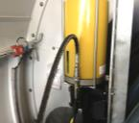
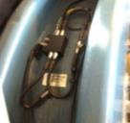
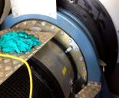
TURBINE: SIEMENS 2.3 MW
MAIN BEARING CONFIGURATION
Auto lube system: Lincoln Quiklub Lubrication System with
15 - litre reservoir and electric grease pump that feeds a 6-port Lincoln SSV metering valve, distributing grease to 3 bearing housing fittings at the top and 2 sides of the bearing housing.
System lube cycle settings are governed by the turbine control system
System is designed to lubricate the bearing for 1-year without the reservoir being re-filled.
The Lincoln lube system reservoir holds about 30 lbs. of grease. Two 5-gallon pails are recommended to perform an effective purging of the bearing and to fill the reservoir
LINCOLN AUTO LUBER PUMP
GREASE
METERING VALVE
MAIN BEARING
The bearing housing has 4 inspection ports on each side (hub and gearbox).

Slide 38
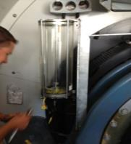
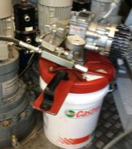
Changeover PROCEDURE
Remove all previous grease from the auto lube reservoir. Clean the reservoir and pump inlet.
If used, clean pail pump and follower plate. Install the new grease 5-gallon pail. Operate the pump until all old grease is purged from the outlet hose to waste
Pump new grease into the Quiklub reservoir about 1 / 4 full
Remove old grease manually from each inspection port and take a used grease sample from between the top rollers.
Operate the lube system continuously for about 45 minutes to purge the lines and metering valve
Check the metering valve pressure. It should be between 1800 and 2100 psig.
Set the turbine to pinwheel at low rpm (1 – 2 rpm) .
Pump the remaining new grease into the bearing through the button head grease fitting at the lube system.
CLEANED LUBE RESERVOIR
LINCOLN PAIL PUMP

Slide 39
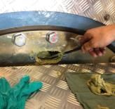
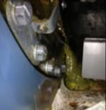
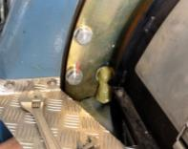

Changeover procedure
A minimal amount of grease will purge from the hub and gearbox side shaft seals.
Expect a total of around 20 lbs. of grease to be pumped into the bearing.
Continue to pinwheel for about 20 minutes until all grease has purged from the inspection ports. Around 12 lbs. of grease should be purged.
Re-assemble all equipment, clean and inspect the area.
Return lube system to its original control settings and put the turbine back into operation.
TOP PORT
PURGING FROM BOTTOM PORT
PURGING FROM LEFT SIDE PORT
PURGING SHAFT

Slide 40
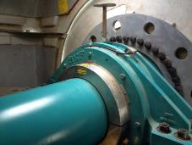
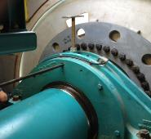
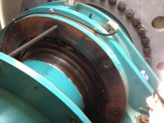
TURBINE: GE 1.X MW
MAIN BEARING CONFIGURATION
SKF and Schaeffler FAG bearings
Manual lubrication, no auto-lube system
Lube cycle every 6 months using 2+ standard 14 oz. / 400 cc tubes
The bearing capacity is about 30 lbs. of grease. Two 5-gallon pails are recommended to perform an effective purging of the bearing and to fill the reservoir
LOCK RING
MAIN BEARING
INSPECTION COVER PULLED

Slide 41
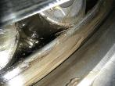
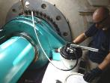
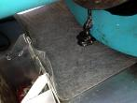
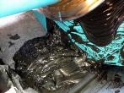
Changeover procedure
Remove lock ring, bolts for inspection cover and pull back cover
If used, clean pail pump and follower plate. Install the new grease 5-gallon pail. Operate the pump until all old grease is purged from the outlet hose to waste.
Remove old grease manually from in between rollers and take a used grease sample from between the rollers. Reinstall cover and lock ring.
Operate the lube pump to fill and purge the bearing housing through the seals and bottom purge plug.
After a while, a mixture of greases will be seen purging.
Expect a total of around 20 lbs. of grease to be pumped into the bearing.
Set the turbine to pinwheel at low rpm (1 – 2 rpm) .
Continue to pinwheel about 20 minutes until all grease has purged from the inspection ports. Around 12 lbs. should be purged.
Pump the remaining new grease into the bearing through the button head grease fitting.
Re-assemble all equipment, and clean and inspect the area.
Put the turbine back into operation.
BOTTOM PURGE PORT
PURGING
FROM SEALS
ALTERNATIVE PROCEDURE: Romax Insight has a hot oil grease flushing procedure that can remove up to 90 % of used grease and iron particulate. Can be used when higher cleanliness is desired and incompatible greases are involved.

Slide 42




GREASE PERFORMANCE METRICS
VISUAL
Borescope every 3 months to look for smoothing or verify no damage has been caused by grease incompatibility or inadequate lubrication. Use the proper procedure, with pictures labeled with location.
TEMPERATURE
Ensure no main shaft bearing temperature alarms are triggered and trends do not begin to differ significantly from neighboring turbines.
VIBRATION
GREASE
SAMPLING
Compare vibration trends to historical data.
Compare iron (Fe) trends.

Slide 43
PLEASE CONTACT:

