Slide 1
Complete Satisfaction Program

Slide 2
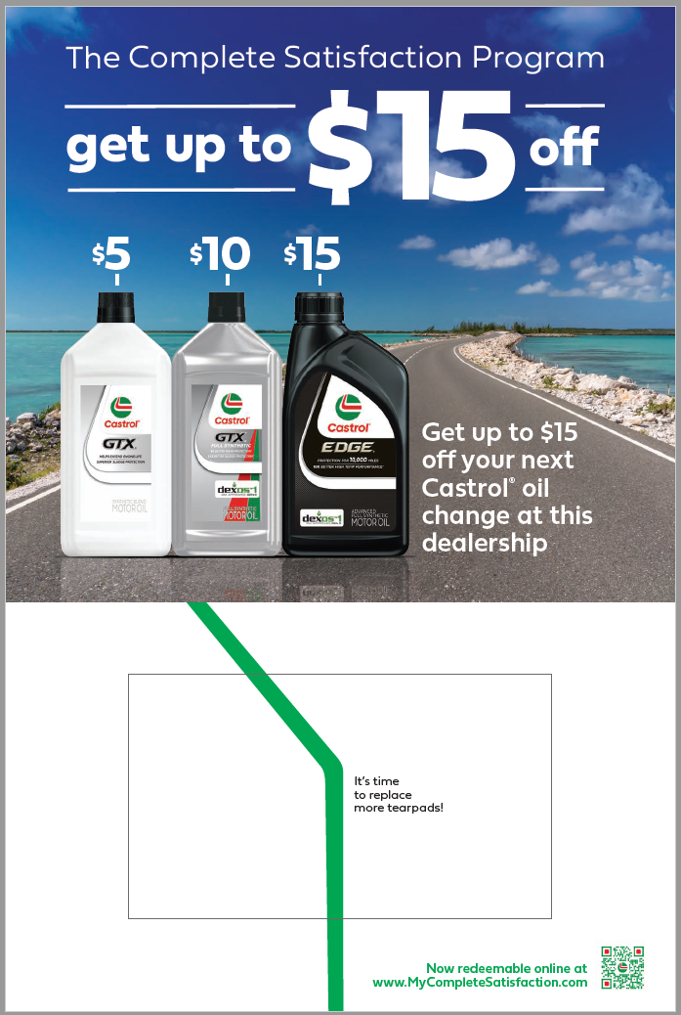
2024 Complete Satisfaction Program Update
YEAR-LONG DIGITAL OFFER DRIVES LOYALTY AND TRADE-UP AT NEW CAR DEALERSHIPS
Consumers submit a digital rebate along with dealership repair order (RO).
Consumers will be able to scan a QR code or enter the URL to redeem the rebate.
Consumers will receive an e-Coupon via email for their next Castrol oil change.*
Dealers will be able to scan a QR code or enter the URL to the e-Coupon redemption website to get reimbursed for redeemed e-coupons. Reimbursements are processed every 2 weeks.
Dealers will be able to track all online submissions and payments through the redemption website.
NEW for 2024 - Consumers will receive an email at 120 days after the coupon redemption reminding them to return to the dealer for their next oil change.
* Consumers who do not have an email address or wish not to provide it can mail in their submission and receive the coupon by mail.

Slide 3
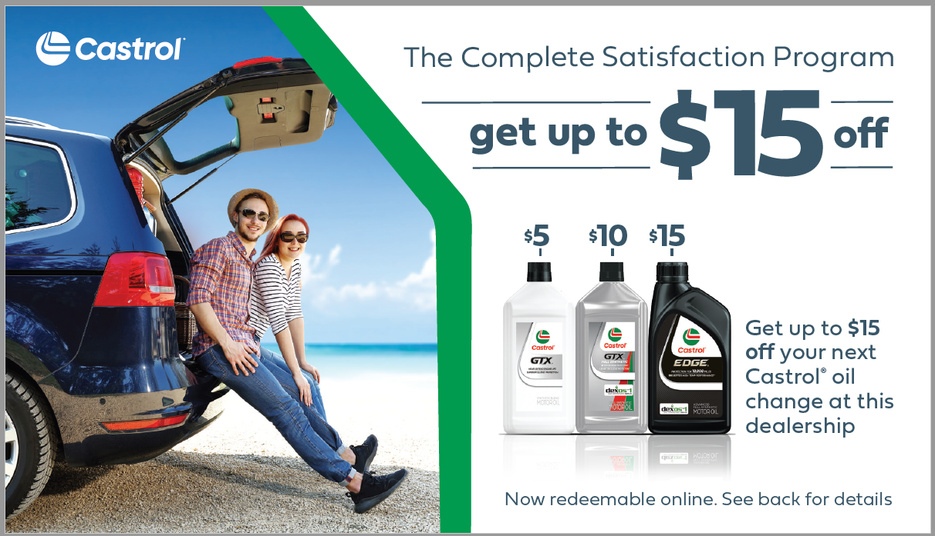
Complete Satisfaction Program Dealer Benefits
Year-long promotion to your customers for Castrol® oil changes.
The consumer can only redeem coupon at your dealership.
Incentivizes trade-up to premium Castrol® products.
Differentiation from competition.
Higher margin per oil change.
Dealer takes advantage of advertising savings.
Promotes service drive loyalty.
Increases customer satisfaction (CSI).

Slide 4
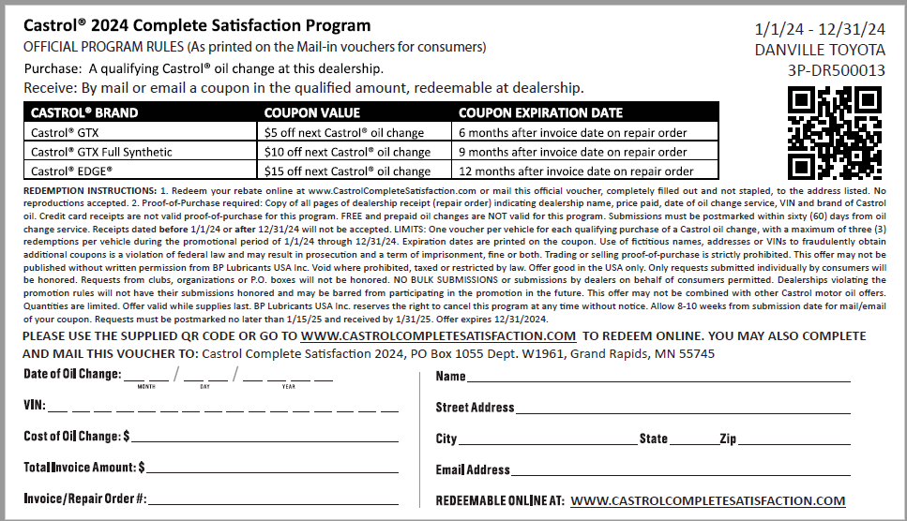
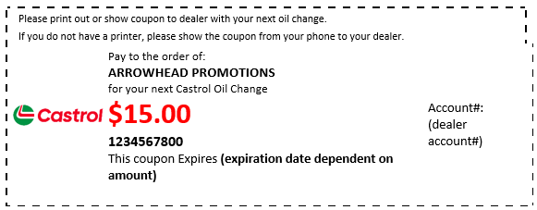
Complete Satisfaction Submission Process
How it Works:
Consumer purchases a Castrol® oil change at your dealership.
Consumer scans QR code or goes to www.CastrolCompleteSatisfaction.com and fills out the digital redemption online and attaches RO.*
Consumer receives e-Coupon made out to dealership for their next Castrol® oil change!
Consumer has until the expiration date to use e-Coupon for next Castrol® oil change at dealer.
* Consumers who do not have an email address or wish not to provide it can mail in their submission and receive the coupon by mail.

Slide 5
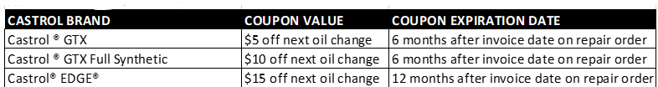
Complete Satisfaction Program Overview
$0 / free oil changes do not qualify.
Consumer has 60 days from the repair order date to submit for the rebate.
Consumer receives an e-Coupon via email.*
e-Coupon payable to the servicing dealer to drive repeat service.
3 e-Coupons issued per VIN, per year.
* Consumers who do not have an email address or wish not to provide it can mail in their submission and receive the coupon by mail.

Slide 6
Complete Satisfaction Program Overview
2024 ENROLLMENT PROCESS FOR DEALERS
ALL active enrolled dealers will be automatically enrolled in the 2024 program.
Late December 2024 starter kits will arrive at dealers.
2024 CSP Dealer Website access
Program Website: Access for Dealers – www.CastrolCompleteSatisfaction.com/Account
Dealers can order additional vouchers.
Dealers have access to redemption reports.
Dealers can track e-Coupon submissions and reimbursements/payments.
Update payment information to enroll in Direct Deposit.
e-Coupon Access for Dealers – www.CastrolCompleteSatisfaction.com/redeem
Dealers can submit customer e-Coupons for reimbursement.
2024 ENROLLMENT PROCESS FOR DEALERS
ALL active enrolled dealers will be automatically enrolled in the 2024 program.
Late December 2024 starter kits will arrive at dealers.
2024 CSP Dealer Website access
Program Website: Access for Dealers – www.CastrolCompleteSatisfaction.com/Account
Dealers can order additional vouchers.
Dealers have access to redemption reports.
Dealers can track e-Coupon submissions and reimbursements/payments.
Update payment information to enroll in Direct Deposit.
e-Coupon Access for Dealers – www.CastrolCompleteSatisfaction.com/redeem
Dealers can submit customer e-Coupons for reimbursement.

Slide 7
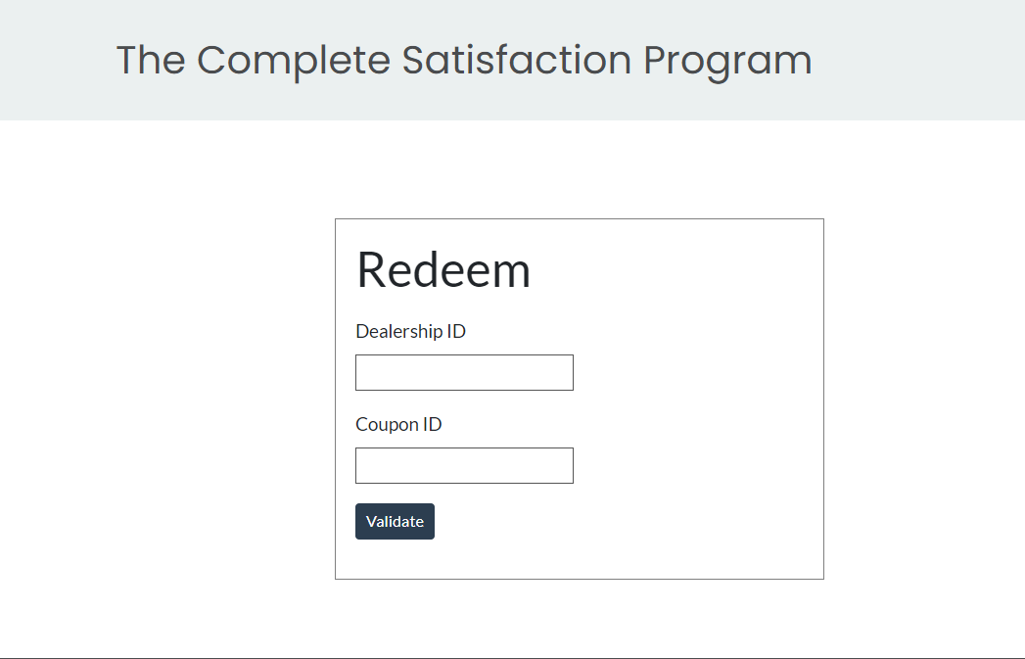
Complete Satisfaction Program Overview
www.CastrolCompleteSatisfaction.com/redeem
Dealer redemption page.
Each dealer received their individual dealer QR code when they received their new POS. Dealer can also use the link above to redeem customer rebate coupons.
New dealers will be sent their QR code along with their welcome POS kit once enrolled.

Slide 8
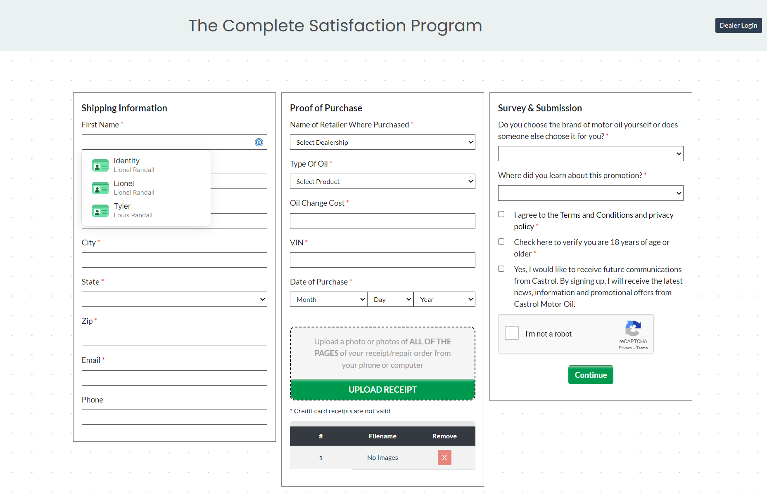
Complete Satisfaction Program Overview
www.CastrolCompleteSatisfaction.com:
Consumer online rebate submission page.
Consumers fill out the submission page and attach their RO.

Slide 9
Program Website www.CastrolCompleteSatisfaction.com/account

Slide 10
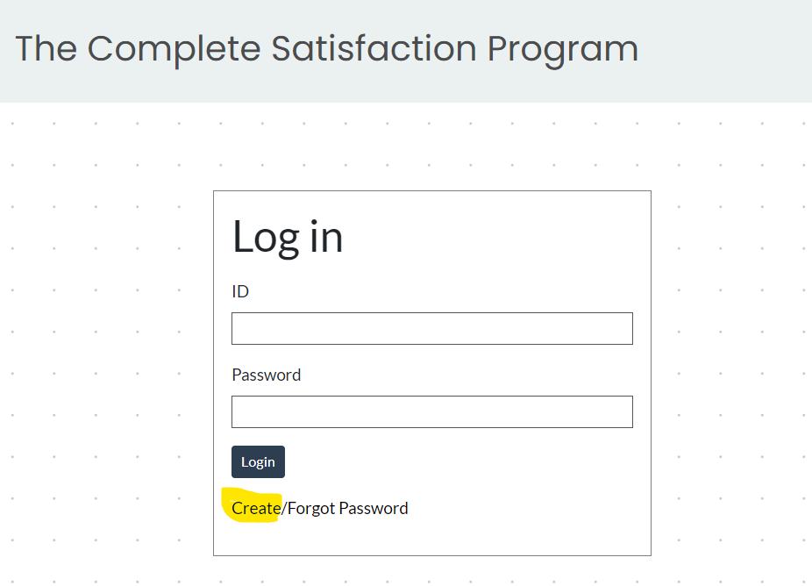
Dealer Login
www.CastrolCompleteSatisfaction.com/account
Once enrolled, each dealership will be provided a unique USER ID.
Dealer will need to click on Create Password before continuing.
Dealer will need to verify their address and contact info.
Dealer will be able to enroll in direct deposit of their reimbursements.

Slide 11
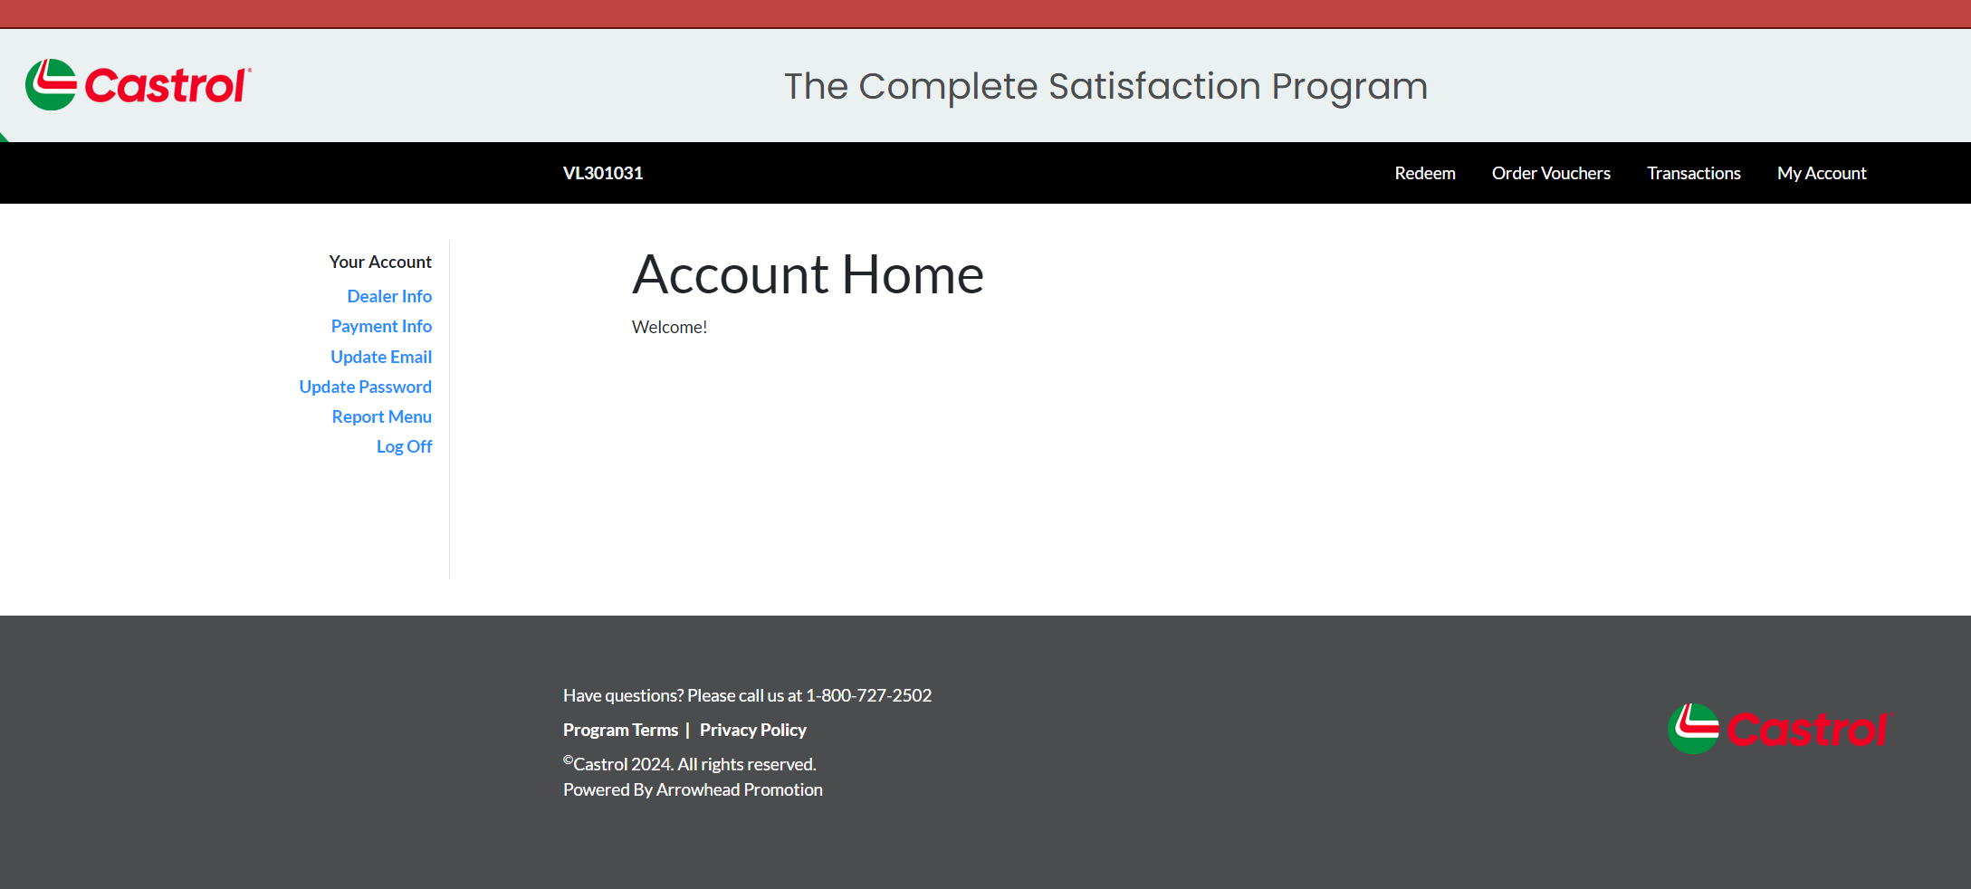
www.CastrolCompleteSatisfaction.com/account
Dealer Login
Click on PAYMENT INFO to enroll in DIRECT DEPOSIT.

Slide 12
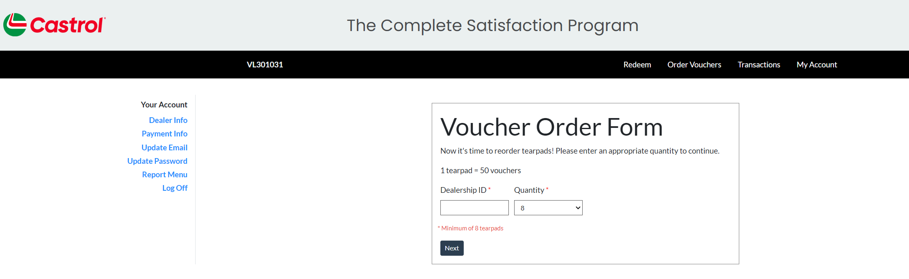
Voucher Ordering
Click on ORDER VOUCHERS to start your order or type www.CastrolCompleteSatisfaction.com/order.
Enter Dealer ID and number of vouchers needed. Vouchers are ordered per pack (50 vouchers/pack) with a minimum of 8 packs with additional quantities of 4 packs.

Slide 13
Program Details by Sales Channel

Slide 14
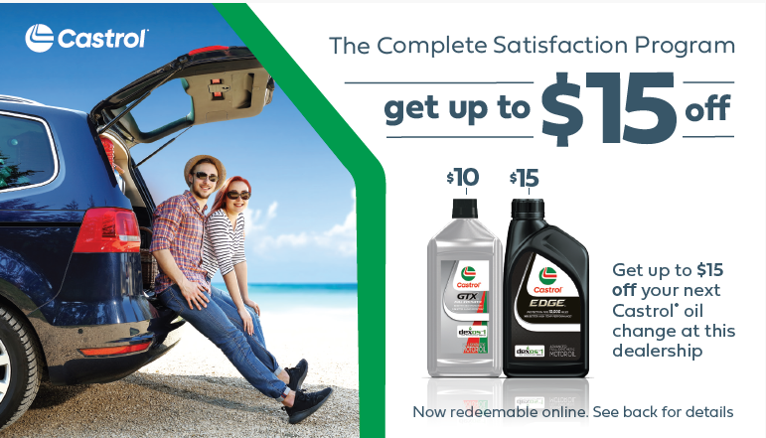
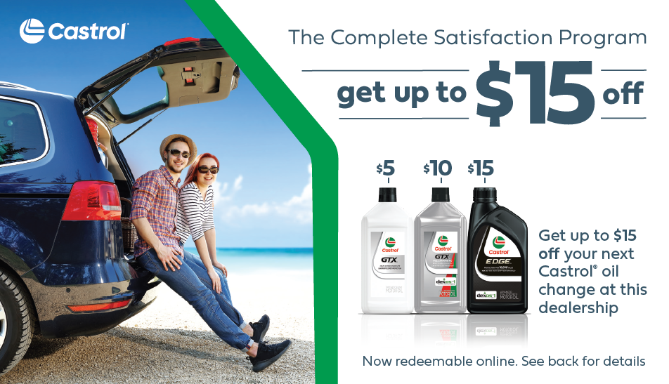
Complete Satisfaction – Direct & Indirect
2024 PROGRAM:
Enhanced data collection.
QR coded vouchers upon enrollment.
Website for re-ordering vouchers.
# of vouchers based on volume.
$0 RO submissions not allowed.
60 days to submit from RO date.
3 e-Coupons per VIN max per year.
NEW for 2024 - Consumers will receive an email at 120 days after the coupon redemption reminding them to return to the dealer for their next oil change.
2 Product Voucher
OTHER DETAILS:
Voucher rates remain $5/$10/$15 (No GTX Eco option available).
Program expiration date is December 31, 2024.
e-Coupon expiration dates: GTX UC = 6 Months; Full Syn = 9 Months; EDGE = 12 Months.
e-Coupons issued will continue to spell out: THESE FUNDS EXPIRE XX/XX/XX.
As a reminder, only New Car Dealer accounts can use Complete Satisfaction.
3 Product Voucher

Slide 15

Complete Satisfaction – Volvo
2024 PROGRAM:
Enhanced data collection.
QR coded, co-branded vouchers.
Website for re-ordering vouchers.
FSM ($0 RO) submissions not allowed.
60 days to submit from RO date.
3 e-Coupons per VIN max per year.
NEW for 2024 - Consumers will receive an email at 120 days after the coupon redemption reminding them to return to the dealer for their next oil change.
OTHER DETAILS:
Voucher rates are $15 for Edge.
Program expiration date is December 31, 2024.
e-Coupon expiration dates: EDGE = 12 Months.
e-Coupons issued will continue to spell out: THESE FUNDS EXPIRE XX/XX/XX.

Slide 16
Thank you

