Slide 1



Re-Refined Base Oil
Product Performance and Technology

Slide 2
End Of Life Oil
Here’s a staggering fact:
Motor oil that isn’t disposed of properly releases about 25 times more oil into the environment than what spills from all modes of oil transportation combined.
The American Petroleum Institute estimates that if you recycle just two gallons of used oil it can generate enough electricity to run the average household for almost 24 hours.

Slide 3
Why Re-Refined Base Oil?
Making use of a valuable US resource
Reduces the depletion of natural resources/Preserves a non-renewable resource
Lower embedded carbon footprint
Waste reduction
Commitment to a cleaner environment through better waste management, improving circularity of our products

Slide 4
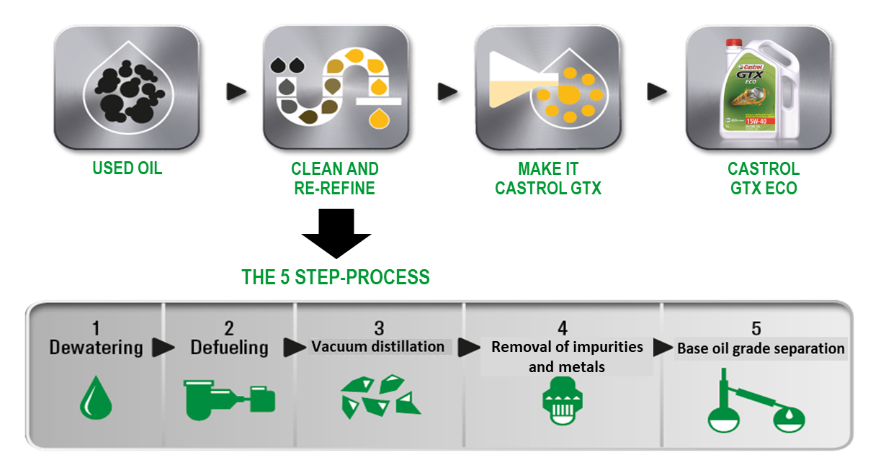
The Re-Refining Process
The re-refining process separates out the best molecules from used oil and combining with high performance additives technology, formulates an oil with exactly the same protection as virgin oil, with lower carbon footprint.

Slide 5
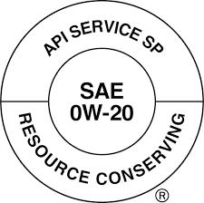

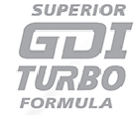


Re-Refined Base Oil Specification
Industry performance certification: API SP (GF-6 the latest standard for modern engines) at par with synthetic blend of other major competitor brands
LSPI (Low Speed Pre-Ignition) tested for GDI/Turbo engines
LSPI is caused by high pressure build up in the cylinder of the engine which can damage your car’s engine

Slide 6
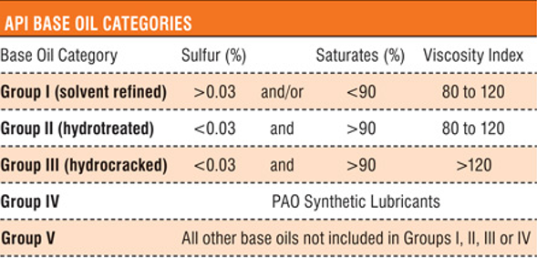
API Base Oil Classification Based On 3 Key Factors
  Saturates – Higher saturates, improved stability, better heat resistance, longer fluid life, cleaner fluid operation
      More saturates is better
  Sulfur – An Impurity
      Less Sulfur is better
  Viscosity Index (VI) - The higher the V.I., the less viscosity changes with temperature
      Higher Index is better
  Other Important Properties – Volatility (Evaporation), Viscosity Stability, Low Temperature Viscosity
Less refined,
Lower performance,
“Conventional”
RRBO
More refined,
Higer performance,
“Full Synthetic”

Slide 7
Technical Conclusions
GTX ESSENTIAL formulation meets the latest API and ILSAC requirements
Formulated with RRBO that has proven high performance and is better than conventional Group II base oils on key properties
  Developed through strong additive and base oil supplier collaborations
A solid steppingstone to upsell to GTX Ultraclean, GTX Full Synthetic and other Castrol brands

Slide 8
Appendix

Slide 9

Base Oil Classifications
Classification of base oils is done by “Groups”
Groups primarily defined by impurities – Sulfur content and amount of saturates
  Mineral or conventional base oil – Group I or II
    Less refined, less expensive
  Synthetic base oil – Group III, IV (PAO) or V (All others)
      More refining or lab produced = more expensive
Synthetics
Group V
Group IV
Synthetics
Group III
Minerals
Group II
Group I

Slide 10
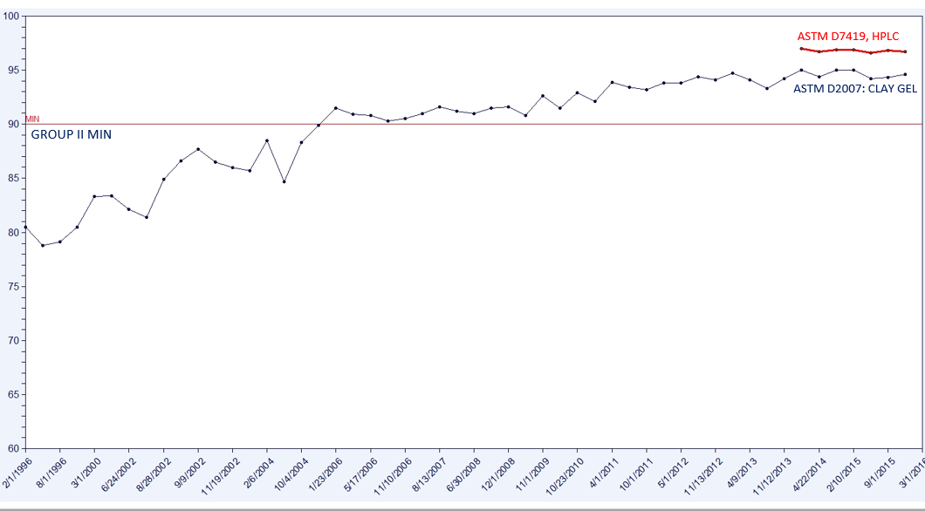
Re-refined Base Oil Quality
Increased saturates over time - increasing base oil stability through improved motor oil quality in the market
Kleen Performance Product Re-refined Base Oils RHT 120

Slide 11
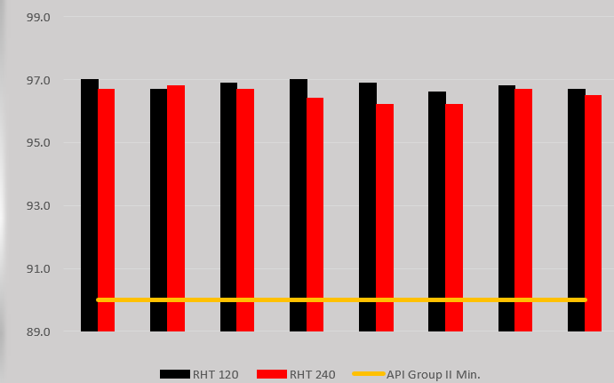
Saturates Level – Re-Refined Base Oil Performance
2014/2015 Saturates – Kleen Performance Product Re-refined Base Oils

Slide 12
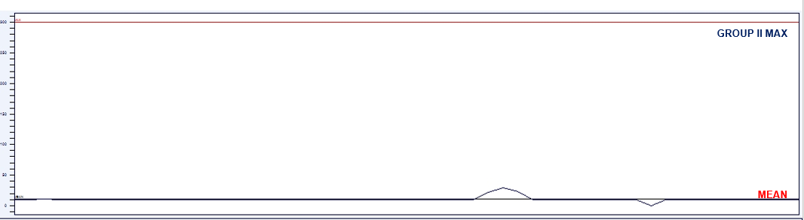
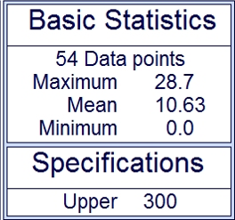
Sulfur Content – Re-Refined Base Oil Performance
Sulfur content very consistent and well below GP II max
*Kleen Performance Product Re-refined Base Oils

Slide 13
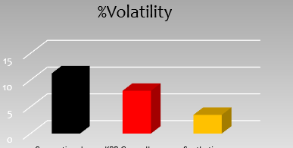
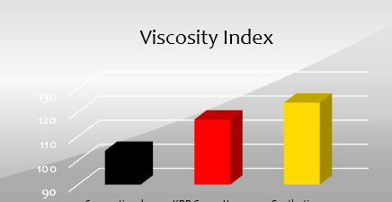

RRBO Base Oil Performance*
Conventional
RRBO
Synthetic
*Kleen Performance Product Re-refined Base Oils

Slide 14
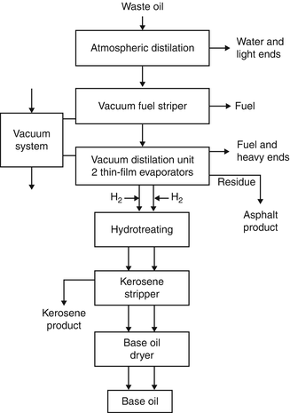
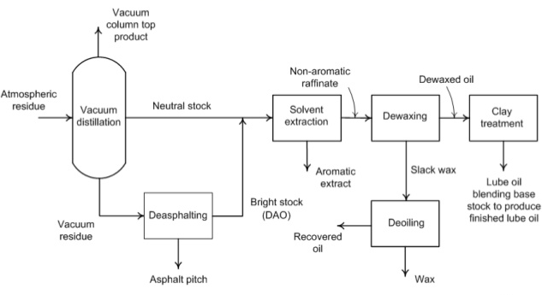
Virgin Base Oil vs Re-Refined Process Examples
Refining Process – Virgin Base Oils
Re-refined Base Oils

