Slide 1
The One-Stop-Shop For All Things Castrol
10/24/2024

Slide 2
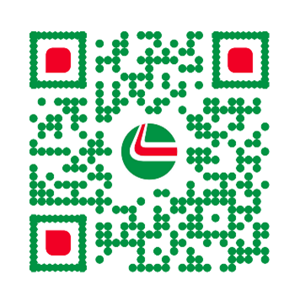
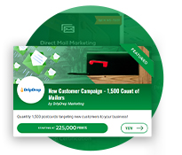
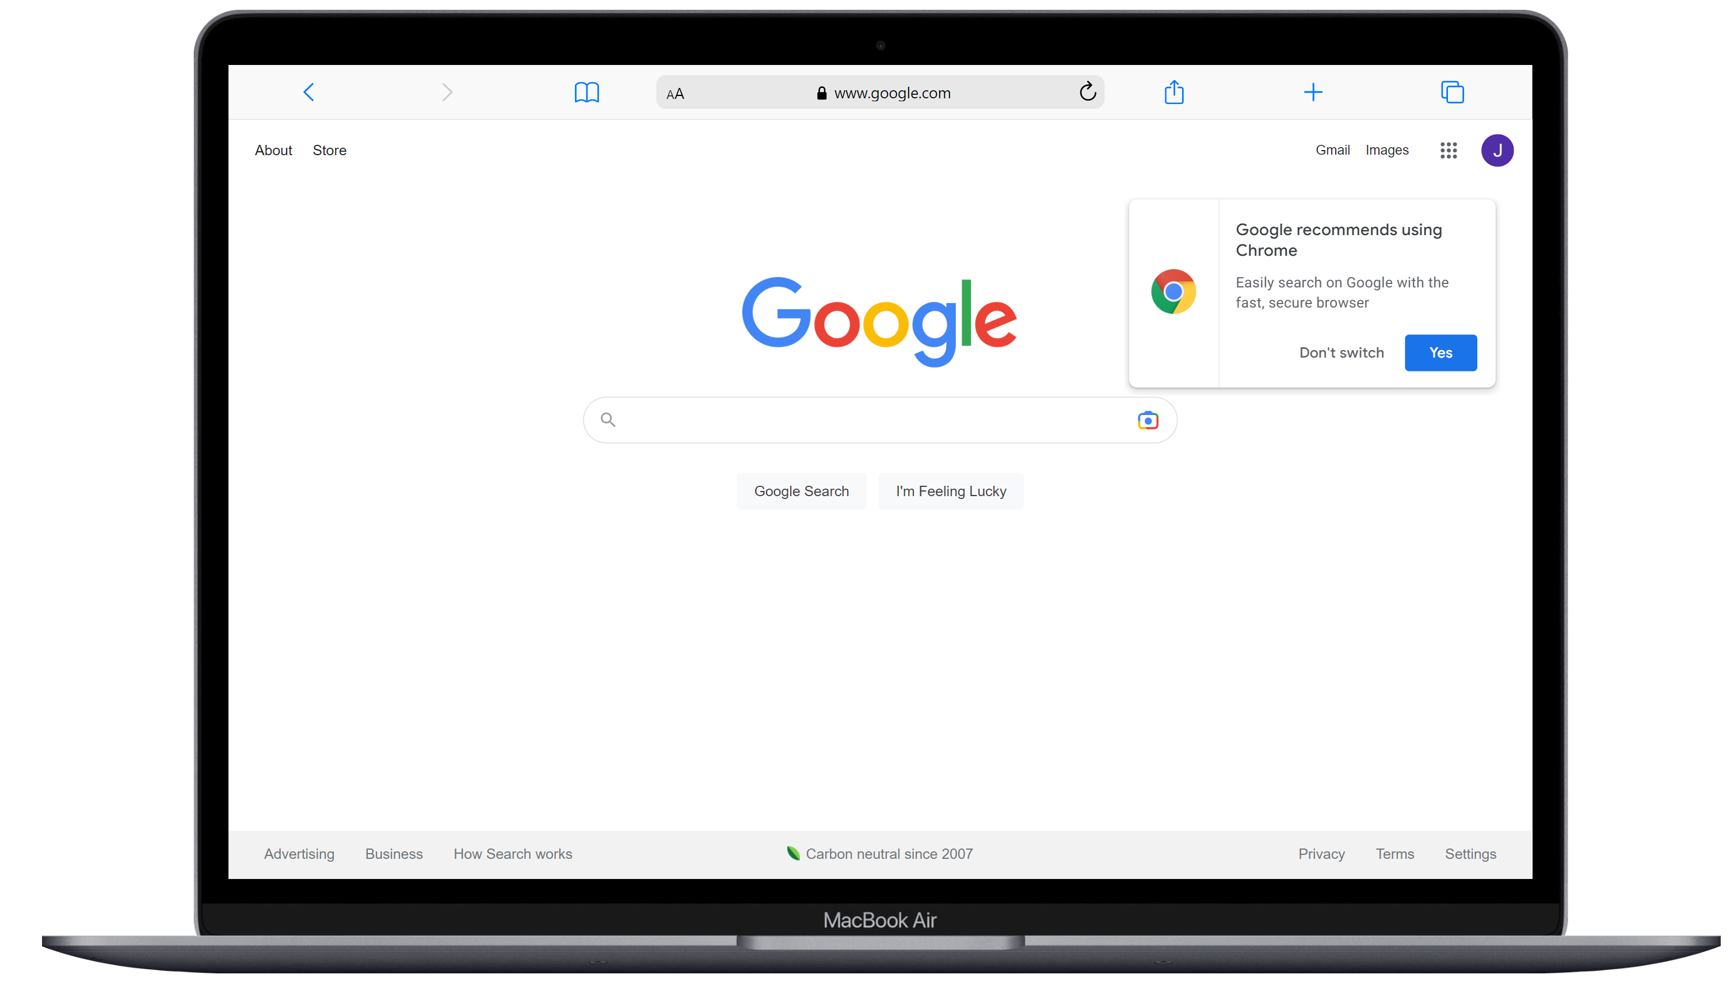
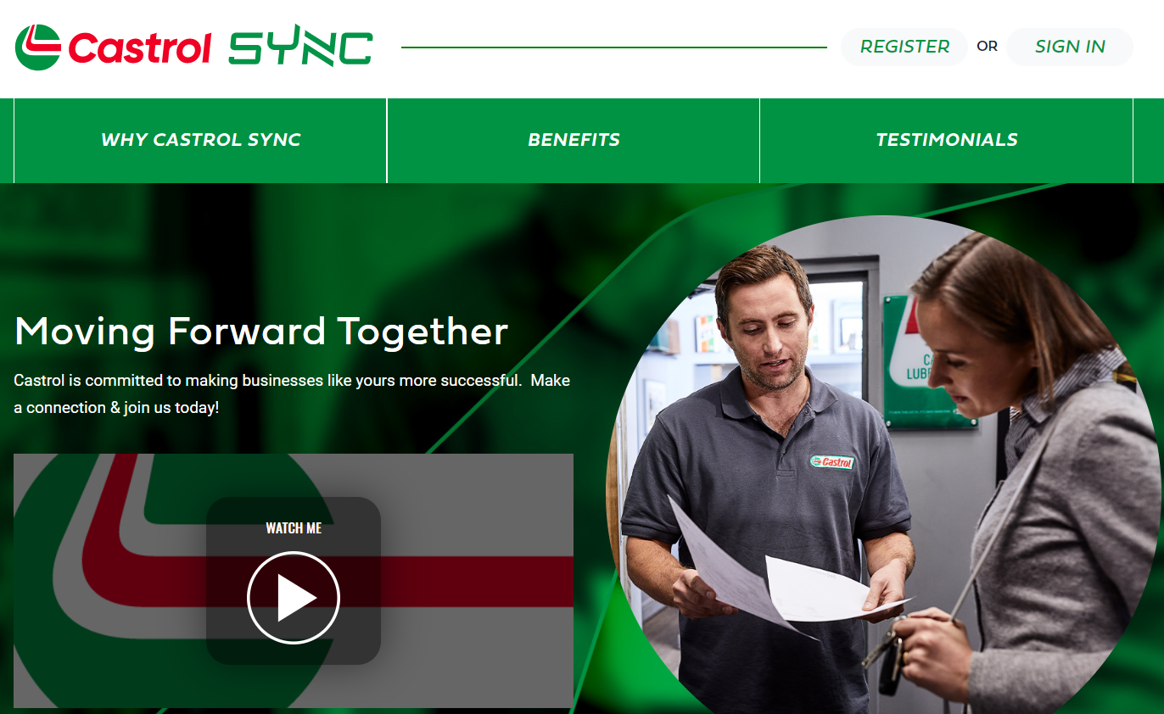
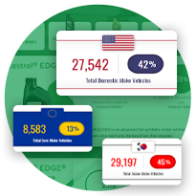
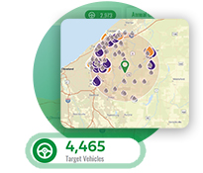
Introducing Castrol SYNC
Simplify the way you do business with Castrol and get rewarded for partnering
Houses Castrol’s loyalty rewards program and allows you to use points to grow your business
Connects your market through data, marketing offers, and consumer promotions
Provides tools and proprietary insights on each shop’s service market

Slide 3
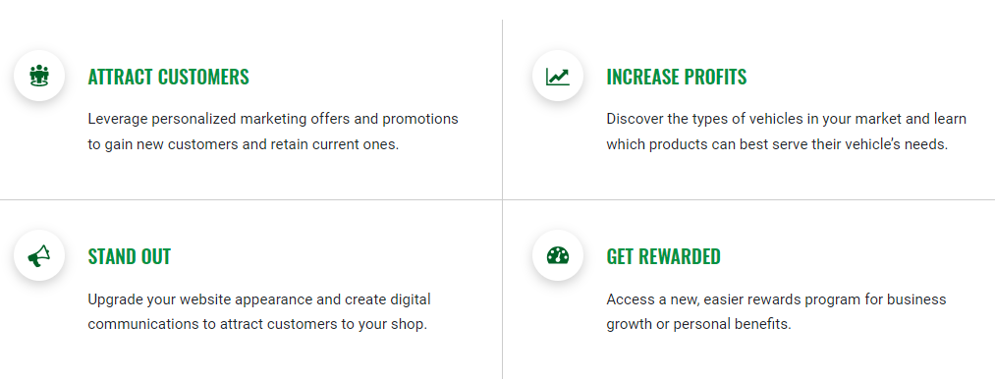


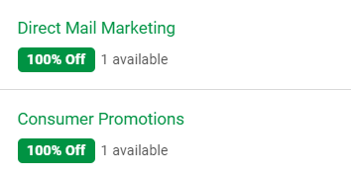
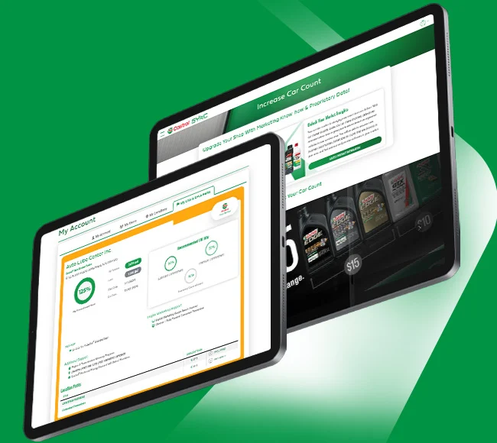
Castrol SYNC Benefits
Simplify the way you do business with Castrol and get rewarded for partnering

Slide 4
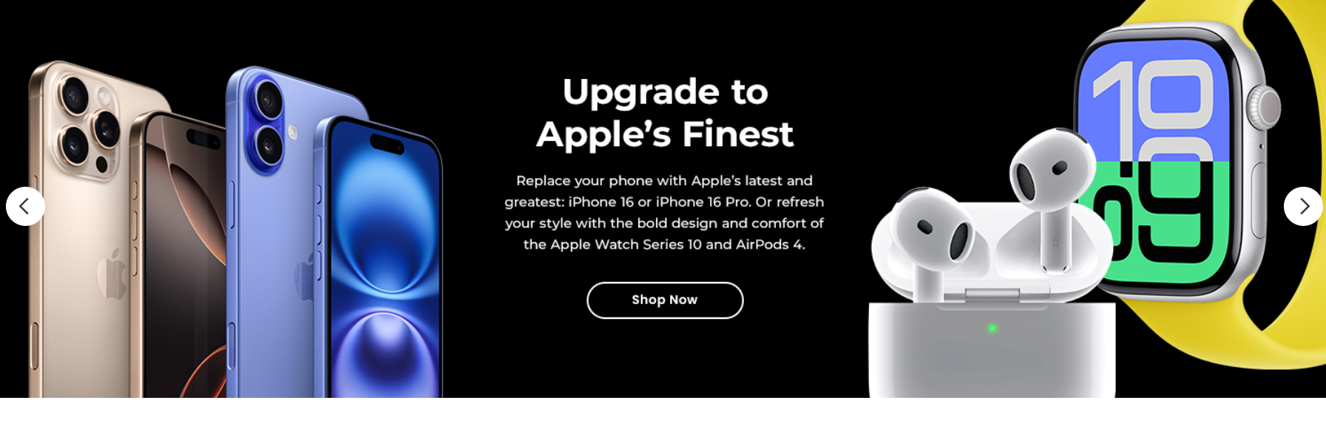
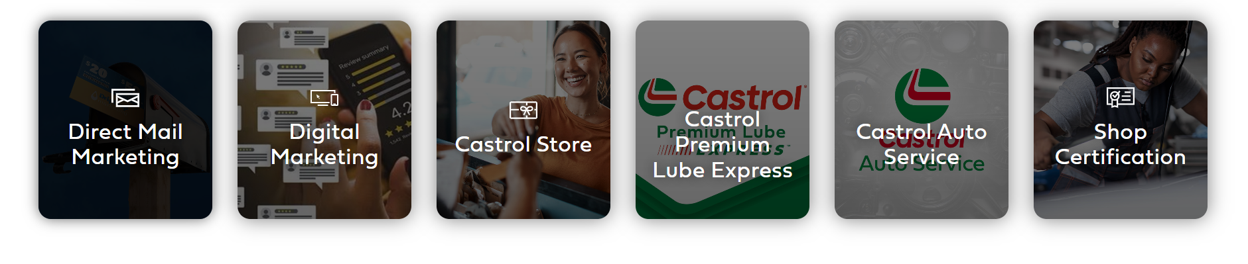
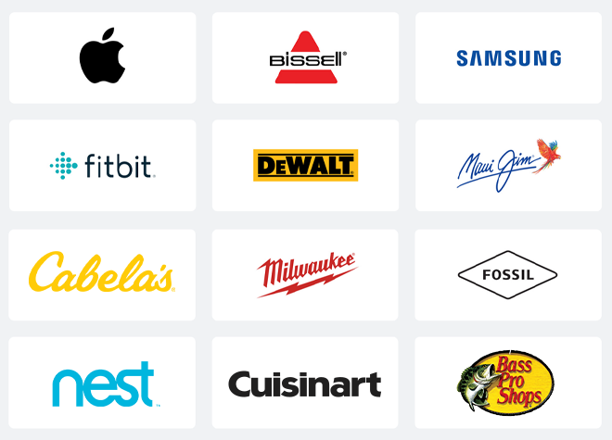
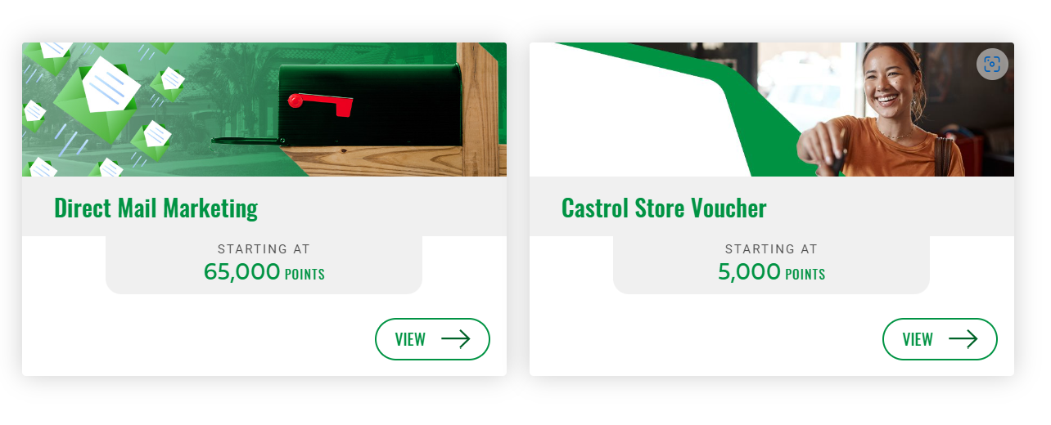
Redeeming Points
The more you buy, the more points you earn
Leisure Rewards
Shopping perks as a loyal Castrol partner
Offers and Promotions
Unbeatable options to help your business stand out
Business Rewards
Invest points back into your business for even more success

Slide 5
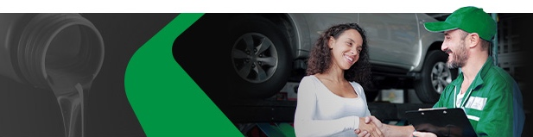
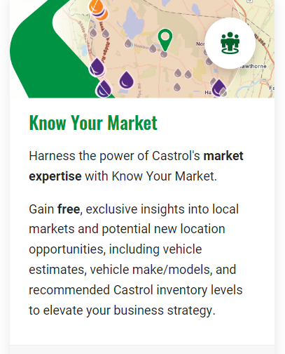
Know Your Market
Free, exclusive insights into local markets and potential location opportunities
SYNC’s Know Your Market tool helps you find a baseline and increase revenue.
Learn how many customers you can reach.
See how competitors are affecting your business.
Increase car counts by targeting the right customers.
1
2
3
Know Your Market Tool Demo
Notes:
Link to Video

Slide 6
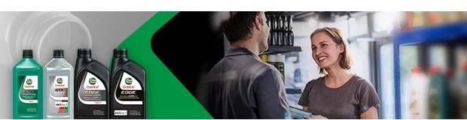
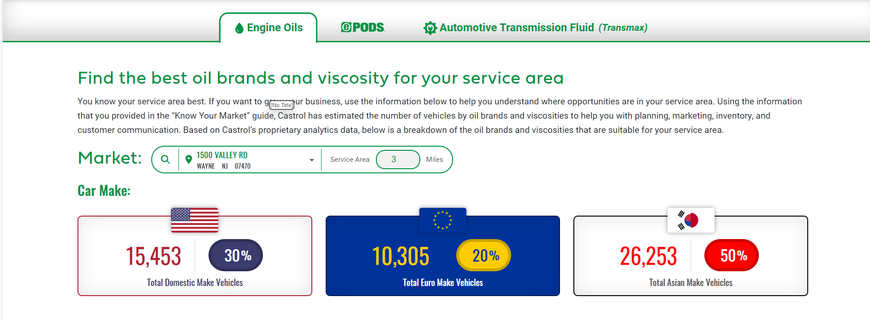
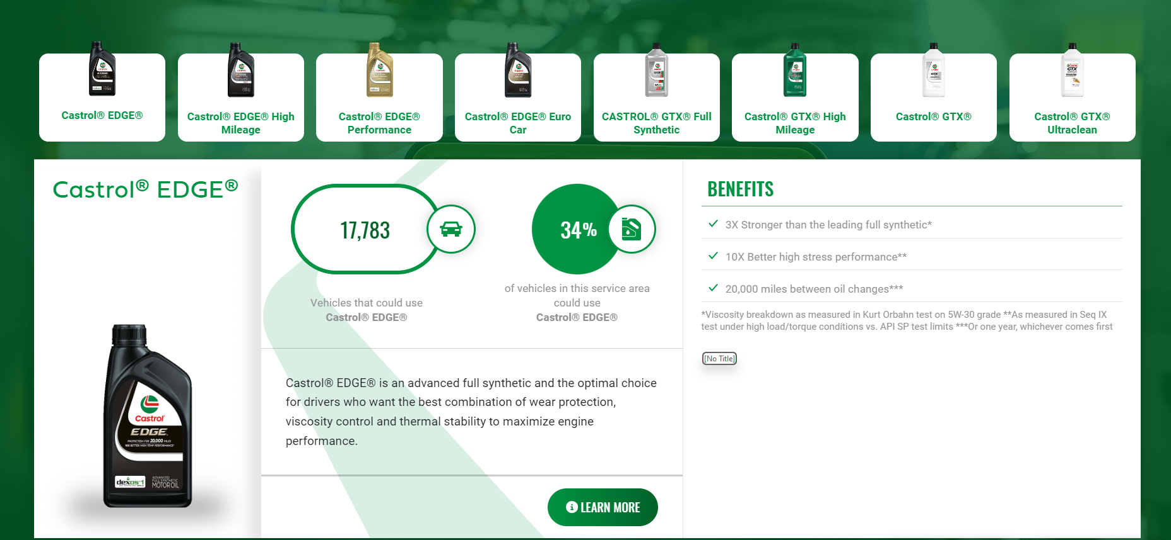
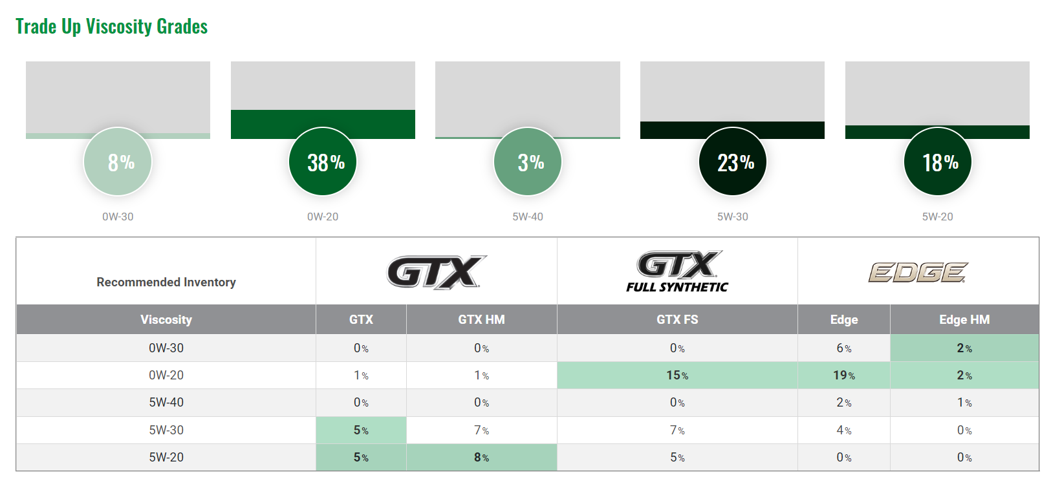
Product Information
Your guide to with planning, marketing, inventory, and customer communication
An organized breakdown of the oil brands and viscosities suited to your service area, right at your fingertips!

Slide 7
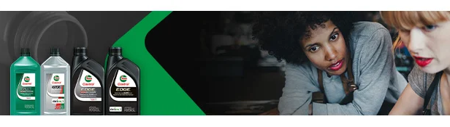
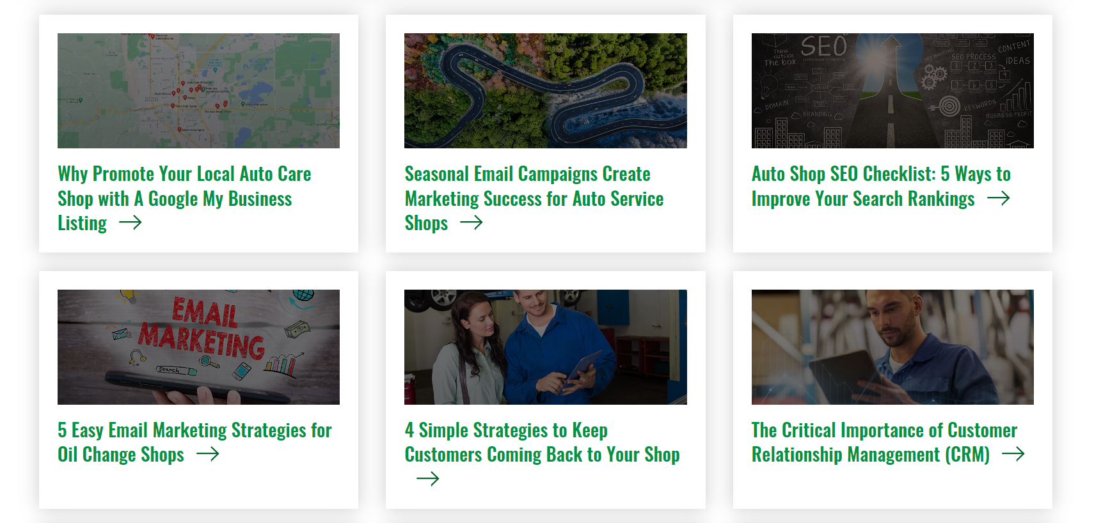
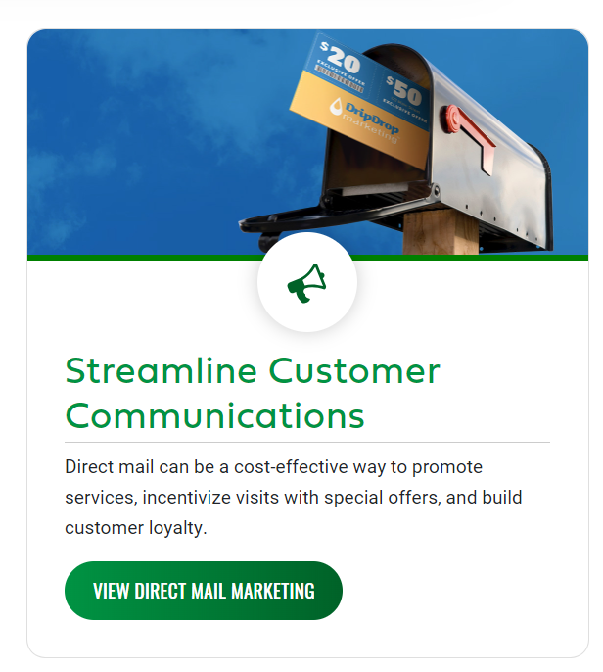
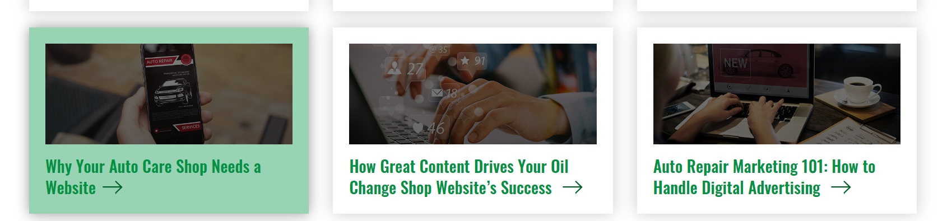
Marketing Blog
Boost success online and bring more shops to your garage
Resources to help your shop grow with SYNC solutions to get there!

Slide 8

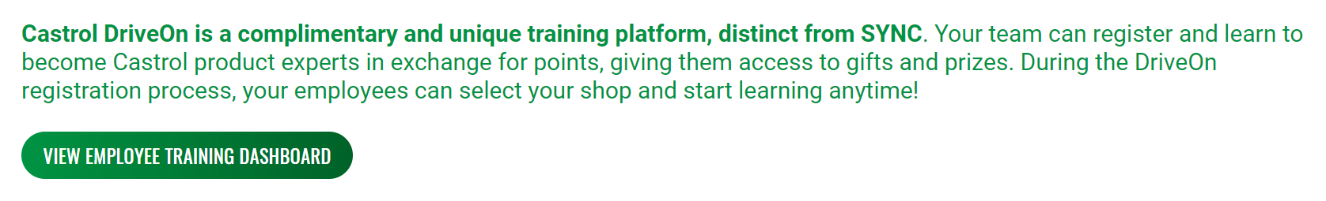
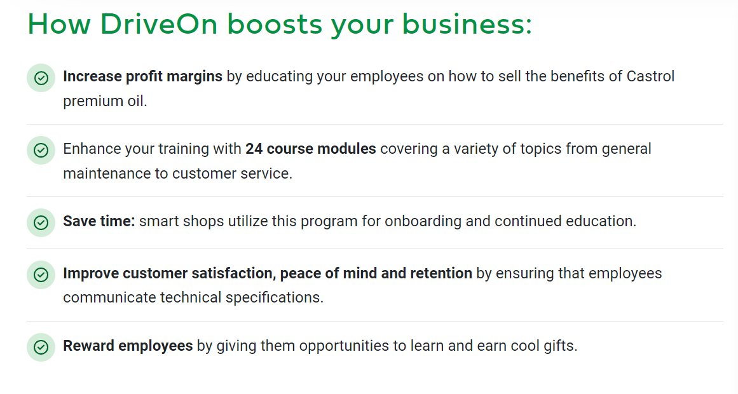
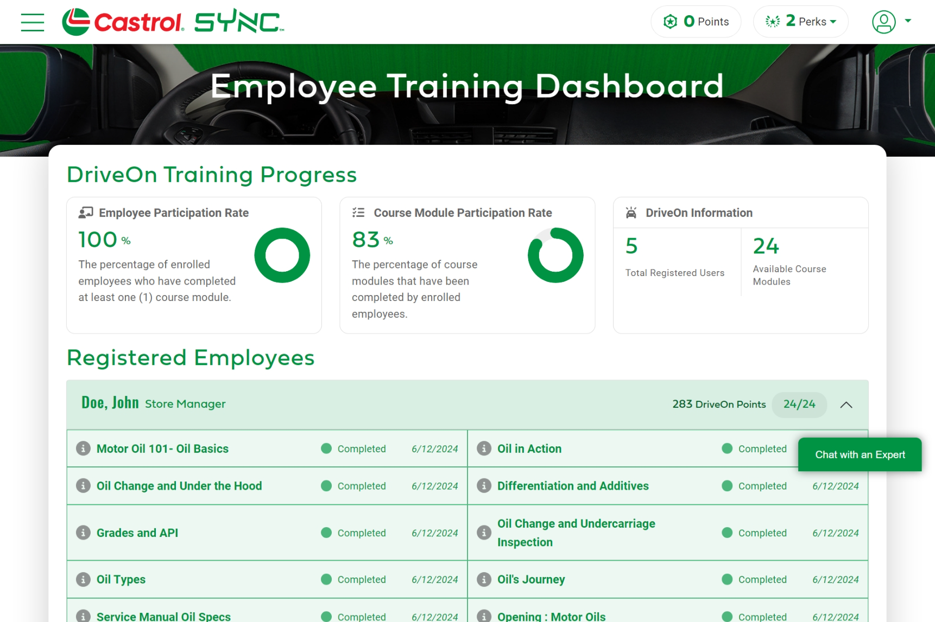
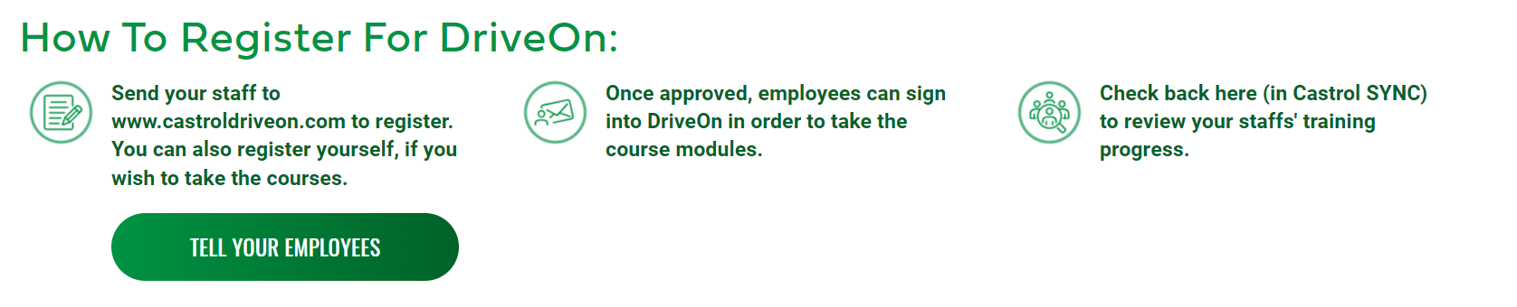
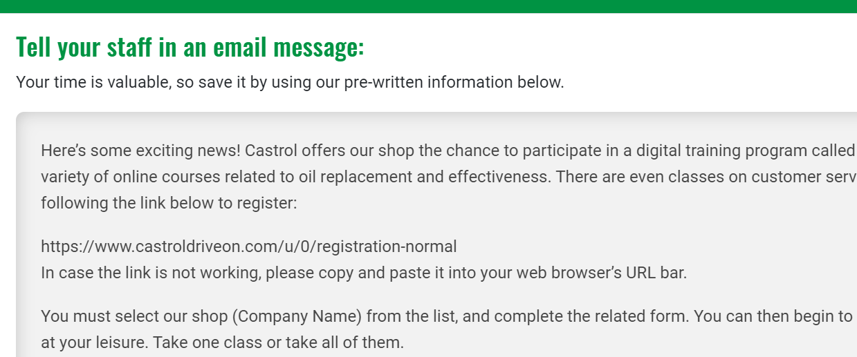
Castrol DriveOn
Educated Employees Fuel Higher Profits

Slide 9
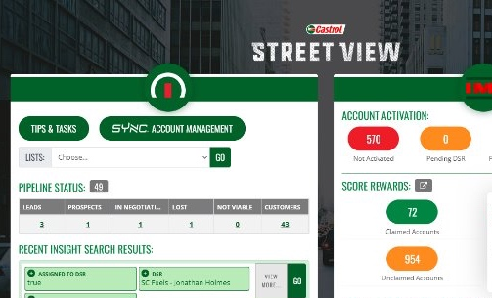
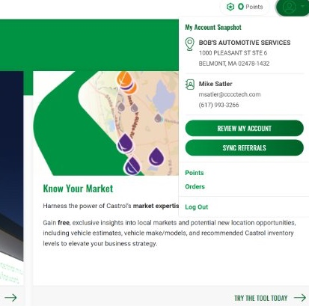
DSR Referral Link
Receive 2,500 SCORE points every time you sign a customer up for SYNC!
To start, identify which customers have not signed up for SYNC.
Two ways to get there:
Your Streetview homepage
Your SYNC profile menu

Slide 10
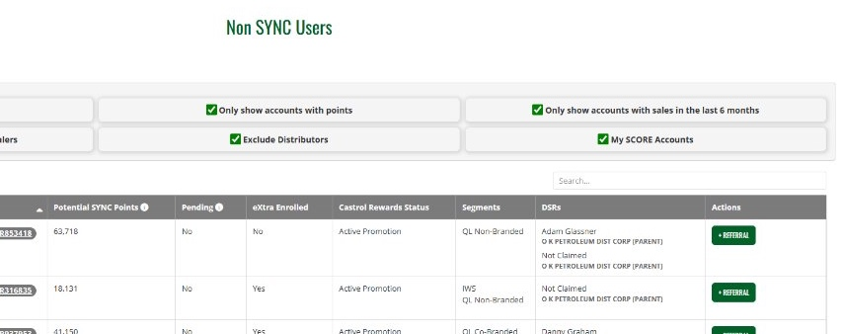
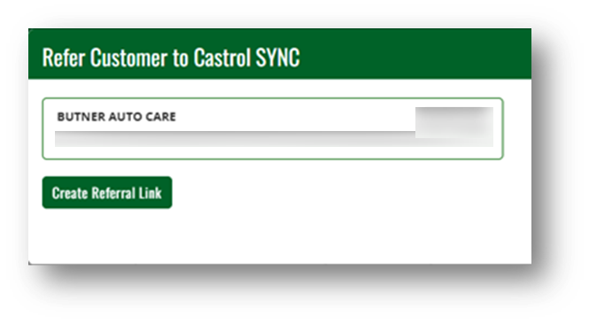
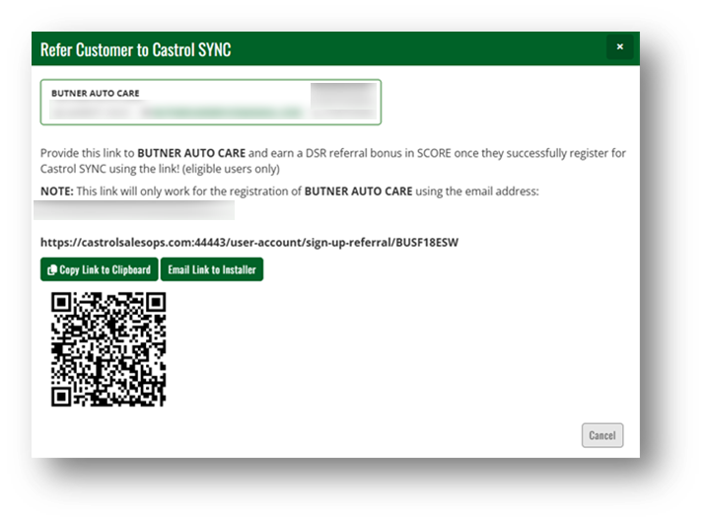
DSR Referral Link
Your list will default to the accounts you have claimed in SCORE
Click the +Referral button
You can copy, generate a personalized email, or use the QR code to share your link

Slide 11
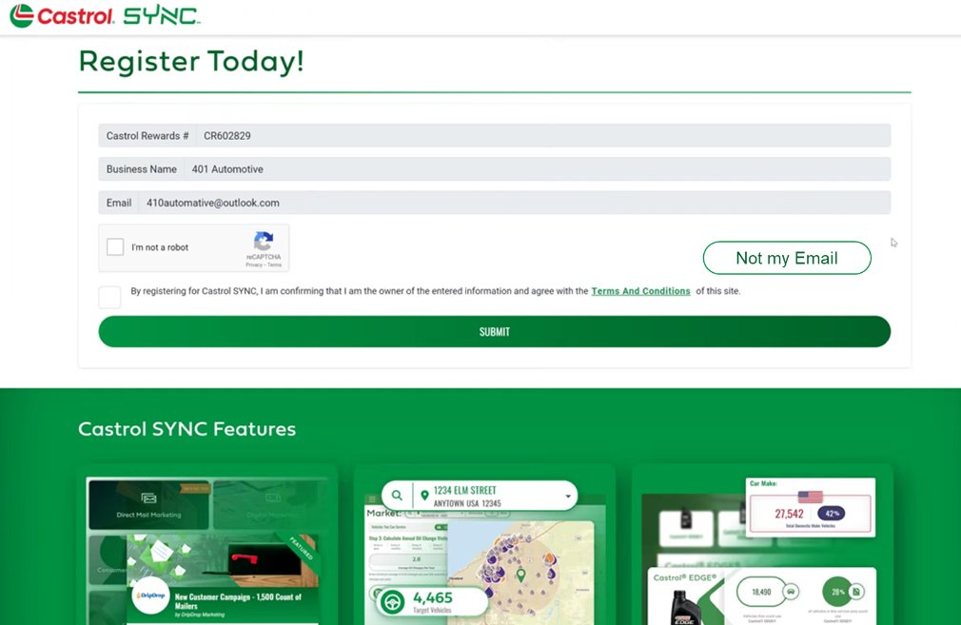
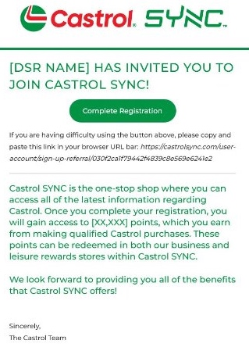
DSR Referral Link
Your link will lead them to a prepopulated form they can submit to sign up. They’ll receive another email to verify, and then they’re in!
If you choose to email your link, it will look something like this:

Slide 12
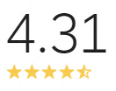
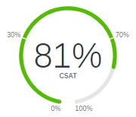
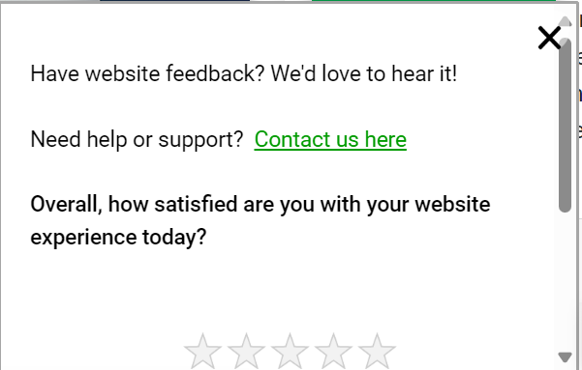
Always Improving
Castrol SYNC aims to be the best tool for DIFM customers
We welcome your feedback! Please reach out to:
Michelle Doyle
Lead Product Manager
michelle.doyle@uk.bp.com
Jake Dostal
Digital Marketing Manager
jacob.dostal1@bp.com
Allison Ling
DIFM Digital Marketer
allison.ling@bp.com
Colin Wiehagen
4C Technologies
cwiehagen@cccctech.com
Updated as of 10/25/2024

Slide 13
Quick Links
If you don’t have access to Castrol SYNC already, please request access here.
Overview Materials
DSR Training Engagement
CPLE Introduction
CAS Introduction
Shop Certification Introduction
SYNC Exclusives
Product Information Tool
Know Your Market Tool
Know Your Market Tool (Demo)
Castrol Marketing Blog
Castrol DriveOn
DripDrop Marketing
Kukui
Contact Us

Slide 14

Thank You!

