Slide 1

Castrol Distributor Rewards
How to Renew - Overview

Slide 2
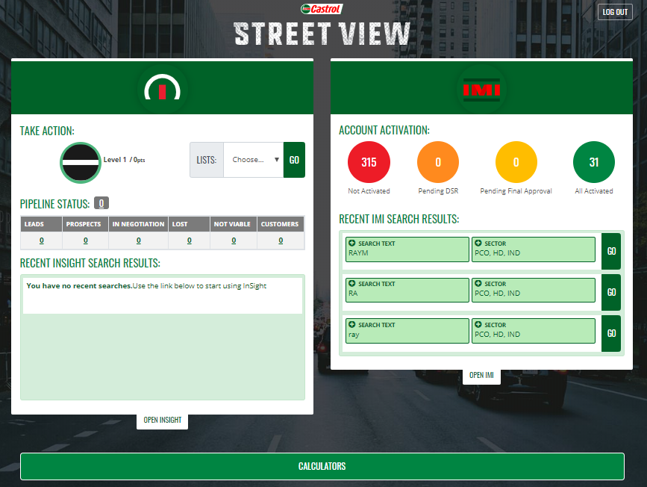

Accessing the Streetview portal
Click this link: https://castrolstreetview.com/sso/
Log in and go to Castrol sites and select Streetview
Once logged in select “Open IMI”
Click Here

Slide 3
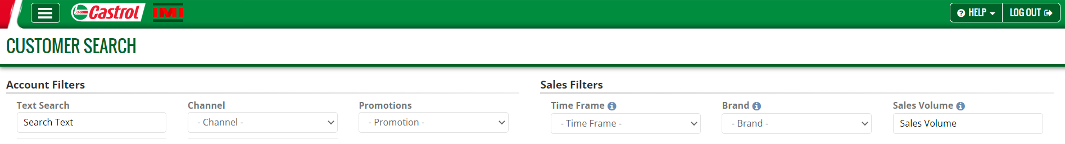
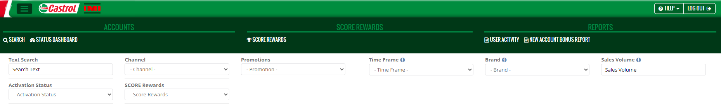
Navigating the IMI
Select the three horizontal bars in the top left-hand corner
Choose “Castrol SCORE Rewards”
Click Here
Click Here

Slide 4
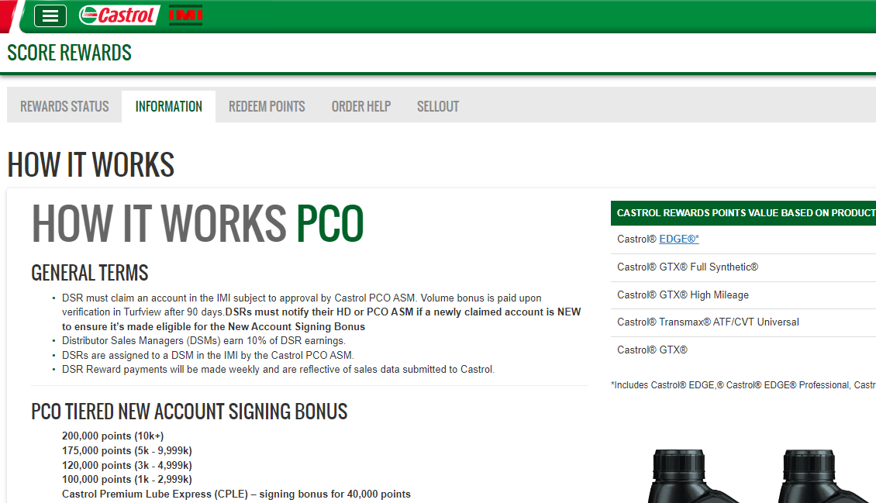
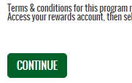
Review the How it Works sections
Read through these sections for changes
Scroll to the bottom, then select “Continue” to proceed

Slide 5
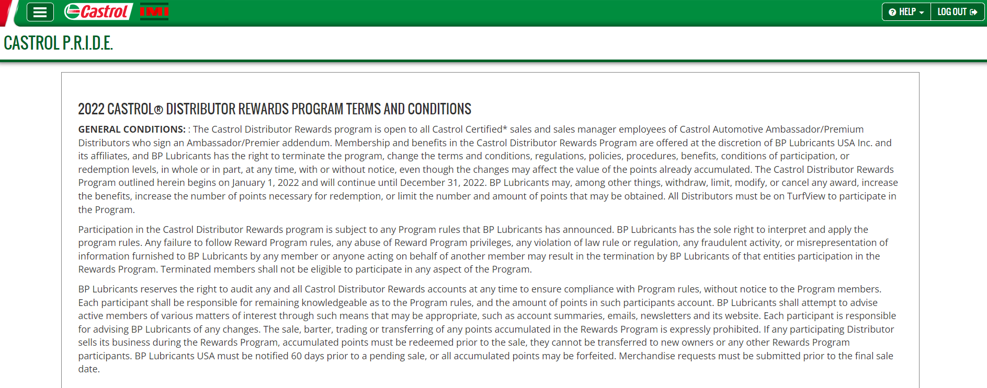

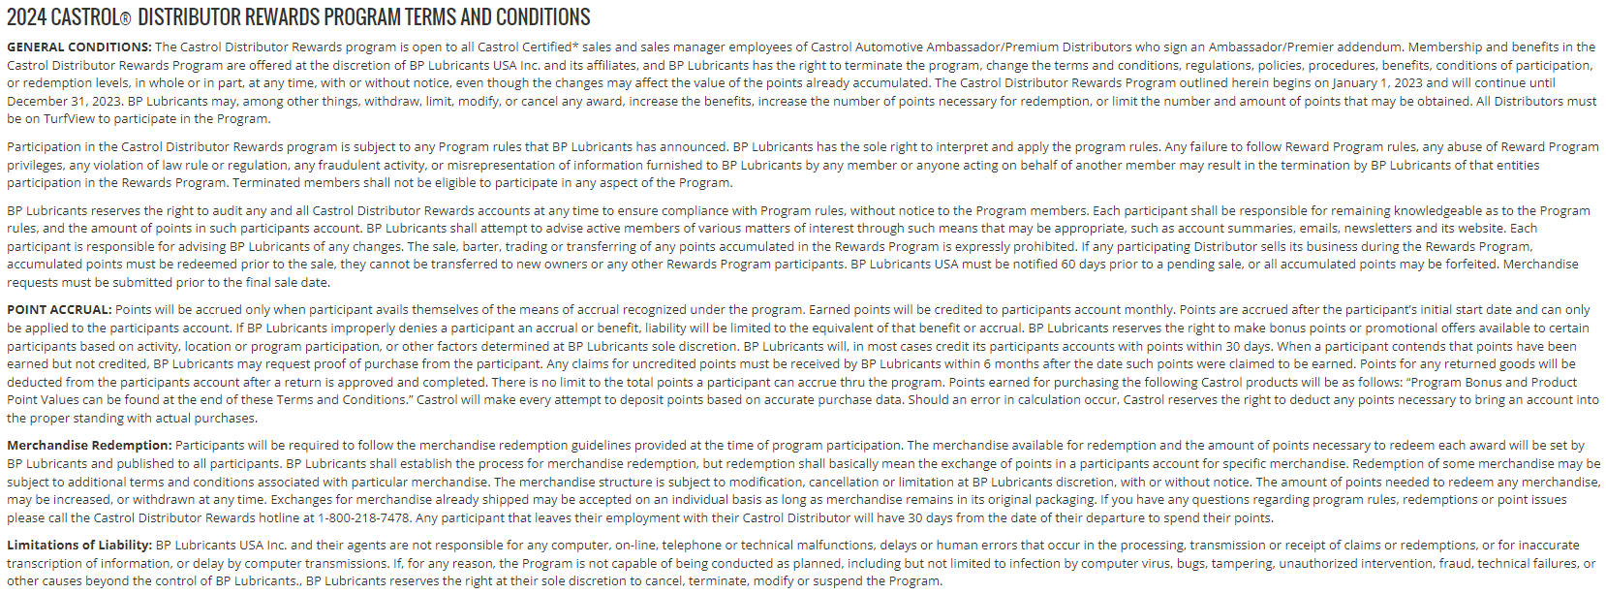
Review current year terms and conditions
Review Program Terms & Conditions
Scroll to the bottom, then select “Continue” to proceed

Slide 6
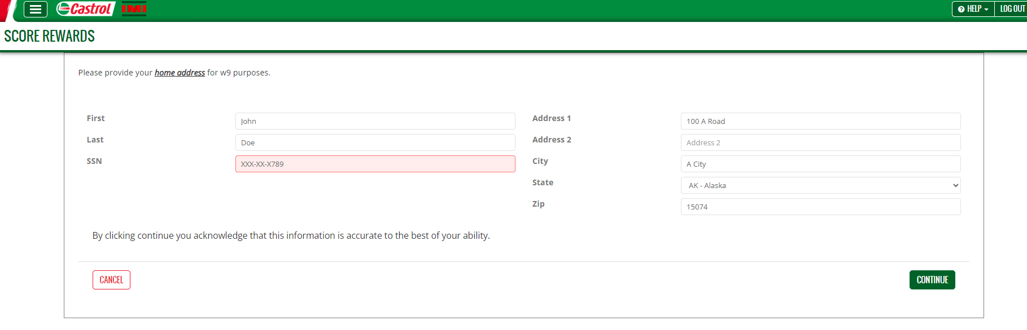
Enter your SSN
Select “Continue” to proceed

Slide 7
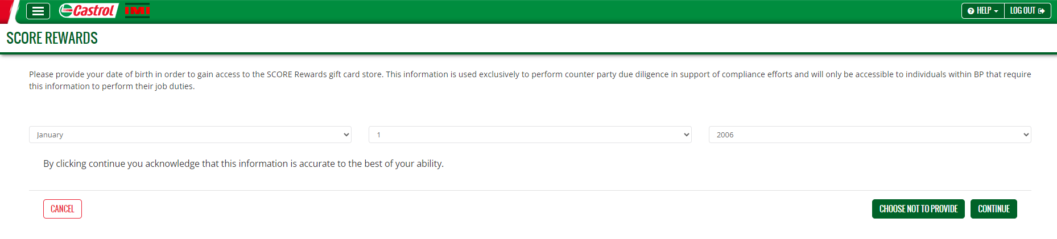
Verify Date of Birth
Provide your date of birth information and click continue or…
If you prefer not to provide your date of birth, click “choose not to provide” and proceed to the next page.

Slide 8
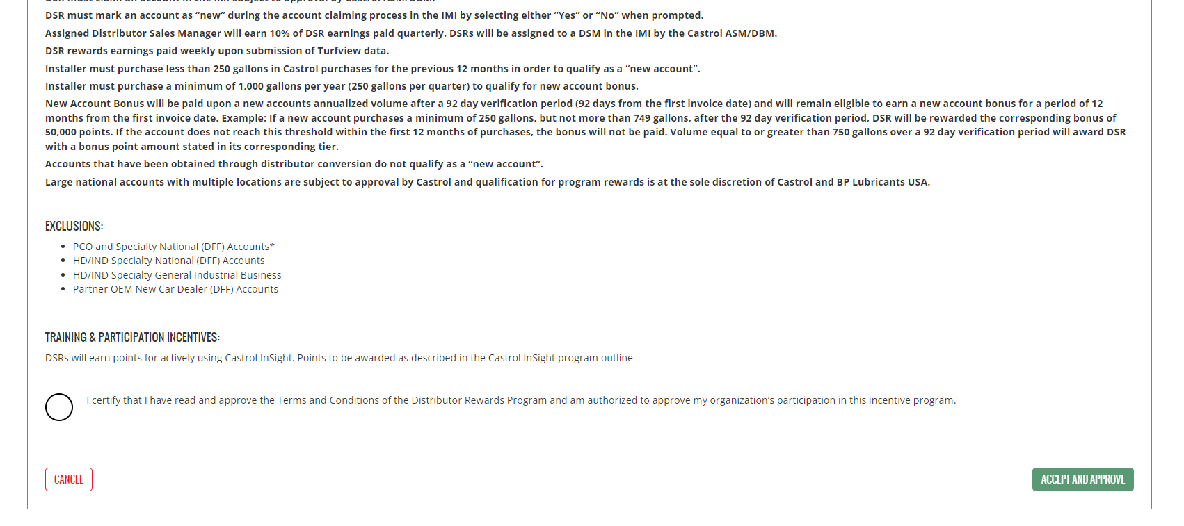
Final Verification… and finish
Tick off I certify and click “Accept and Approve” to complete the renewal

Slide 9
Thank you!
Questions on the Castrol Distributor Rewards Program contact your support team noted below.
  Primary contacts: Castrol Distributor Business Managers & Castrol Area Sales Managers

