Slide 1
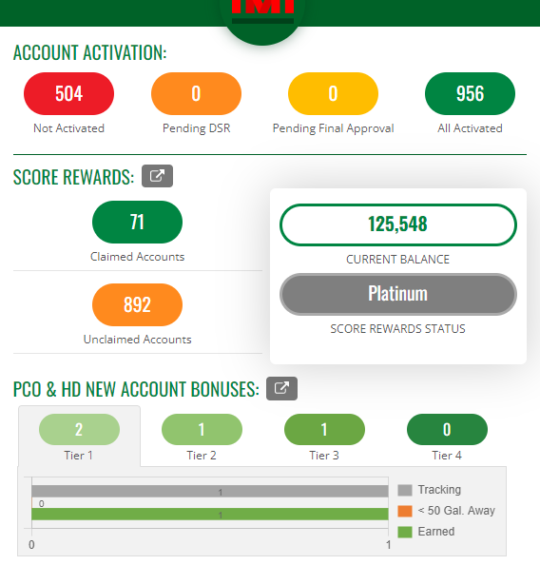

SCORE Dashboard overview – Account Activation
1
2
3
4
Not Activated
  Accounts Castrol ASM and Distributor DSR need to review - ineligible for SYNC or claiming by DSR for SCORE until activated
  DSR should review accounts in this area for new sales opportunities
  DSR must review and complete one of the following actions
    Claim, or ignore accounts
    Note: Castrol ASM must approve ignored accounts
Pending DSR
  Accounts ASM has denied back to DSR for further review
  DSR must complete all actions for activation process to proceed
Pending Final Approval
  Accounts going through the final Castrol onboarding review
All Activated
  All accounts activated by the entire Distributor organization
Example dashboard for review purposes only

Slide 2
SCORE Dashboard overview – Rewards Section
5
3
4
Claimed Accounts
  Accounts DSR has claimed and earns awards on for the purchases of Castrol products
Unclaimed Accounts
  Total Accounts unclaimed by Distributor
  DSR can review for new accounts or ignore if accounts do not make good business sense.
    Note: Castrol ASM must approve ignored accounts
Current Balance
  Total awards DSR earned and can spend on merchandise, travel, entertainment and gift cards*.
SCORE Rewards Status
  Platinum, Gold, or Silver *(see program brochure for details)
See page 3 for report detail.
1
2
Example dashboard for review purposes only
*Gift card annual renewal limits $1,000 per bp Ethics and Compliance guidelines

Slide 3
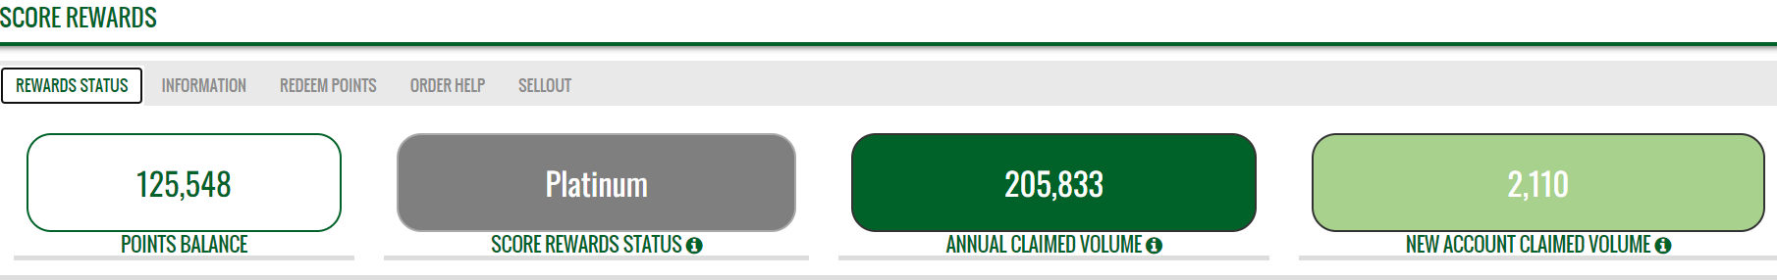
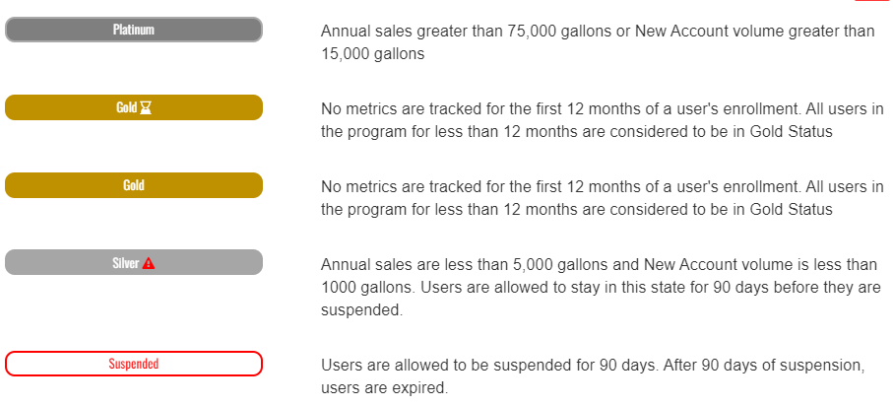
SCORE Dashboard overview – Rewards Report detail
5
Points Balance:
  Total awards DSR can spend on merchandise, travel, entertainment and gift cards*
SCORE Rewards Status:
  Platinum, Gold, or Silver *(see program brochure for details)
Annual Claimed Volume:
  Gallons associated with existing accounts buying Castrol
  *(see pg. 3 of program brochure for existing account award structure)
New Account Claimed Volume:
  Gallons associated with new accounts buying Castrol
  *(see pg. 3 of program brochure for new account award structure)
*Explanation for each volume tier based on gallons sold.
*Gift card annual renewal limits $1,000 per bp Ethics and Compliance guidelines

Slide 4
SCORE Dashboard overview – New Account Volume Report
Tier 1:
  Total new accounts earning DSR awards for buying Castrol based on tier 1 volume requirements shown on pg. 3 of program brochure
Tier 2:
  Total new accounts earning DSR awards for buying Castrol based on tier 2 volume requirements shown on pg. 3 of program brochure
Tier 3:
  Total new accounts earning DSR awards for buying Castrol based on tier 4 volume requirements shown on pg. 3 of program brochure
Tier 4:
  Total new accounts earning DSR awards for buying Castrol based on tier 4 volume requirements shown on pg. 3 of program brochure
See page 5 for report detail.
1
2
3
4
*
5
Example dashboard for review purposes only
*Note: Explanations below apply to each tier in the new account bonus section
  Tracking – number of new accounts being tracked for awards in given tier
  < 50 Gallons away – number of new accounts close to next volume / award tier
  Earned – number of new accounts that already achieved volume requirements tier
*Gift card annual renewal limits $1,000 per bp Ethics and Compliance guidelines

Slide 5
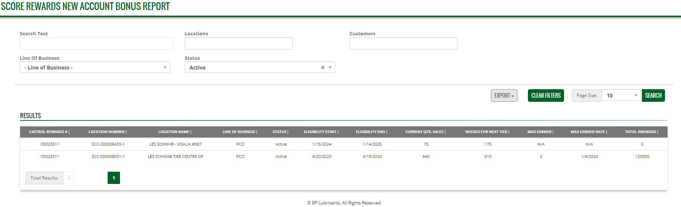
SCORE Dashboard overview – New Account Volume Report
A
B
C
D
E
F
G
H
I
J
K
L
M
N
O
P
Q
R
S
Customer CR #
Customer Location #
Customer
Location Name
*Explanation for each volume tier based on gallons sold.
SCORE Rewards New Account Bonus Report:
  Provides participants with detailed information for all new accounts buying Castrol
  Gives participants the ability to edit, view, and export data for territory management and increased awards
  Detailed description of each section can be found on slide 6

Slide 6
SCORE Rewards New Account Bonus Report descriptors:
  “Search Text” – enter text (CR, Customer Name, etc.) to filter specific customer details from lengthy list
  “Locations” – enter location number to filter specific customer details from lengthy list
  “Customers” – enter customer name to filter specific customer details from lengthy list
  “Line of Business” – drop down menu to filter customer details based on line of business
  “Status” – drop down menu to filter Active and Inactive* customer details *(Inactive means no longer a new customer)
  “Export” – drop down menu giving member the ability to export report sales details to .xls or .csv file format
  “Search” – clickable button allowing member to see specific criteria when fields A-E (above) have data entered
  “Castrol Rewards” – Castrol Customer Record (CR#) field
  “Location Number” – Distributor record for customer number
  “Location Name” – Distributor record for customer name
  “Line of Business” – Identifies what Castrol line of business (PCO, HD, etc.) customer is connected to
  “Status” – Active (default) to show new customer purchases are being tracked for DSR awards
  “Eligibility Start” – date when new account tracking started for customer purchases connected with DSR awards
  “Eligibility End” – date when new account tracking ends for customer purchases connected with DSR awards
  “Current Quarter Sales” – new customer volume purchased in that quarter of 12-month monitoring window
  “Needed for next tier” – new customer volume needed for DSR to achieve next award payout tier
  “Max earned” – Maximum volume earned in the 12-month monitoring window by that new customer
  “Max earned date” – max award tier DSR achieved for customer shown in report
  “Total Awarded” – Total new awards DSR earned for new customer shown in report

