Slide 1
Castrol Distributor Rewards
How to Claim Accounts and Spend Points

Slide 2
Section Summary
How to Claim Activated Accounts
3-5
How to Claim Accounts that are not Activated
6-10
How to Spend Points
11-14
Additional Information
15-16
Order Support
17-18

Slide 3
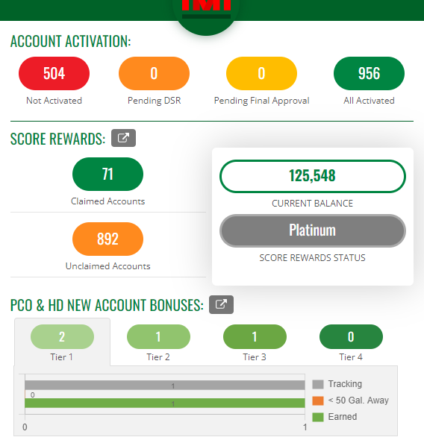

How to Claim Activated Accounts
Activated accounts here are those that have not been claimed by a current DSR
Log into your SCORE Rewards dashboard (IMI) at: https://castrolstreetview.com
After logging in, click “All Activated” to explore accounts you can claim for Castrol awards
Examples shown for reference

Slide 4
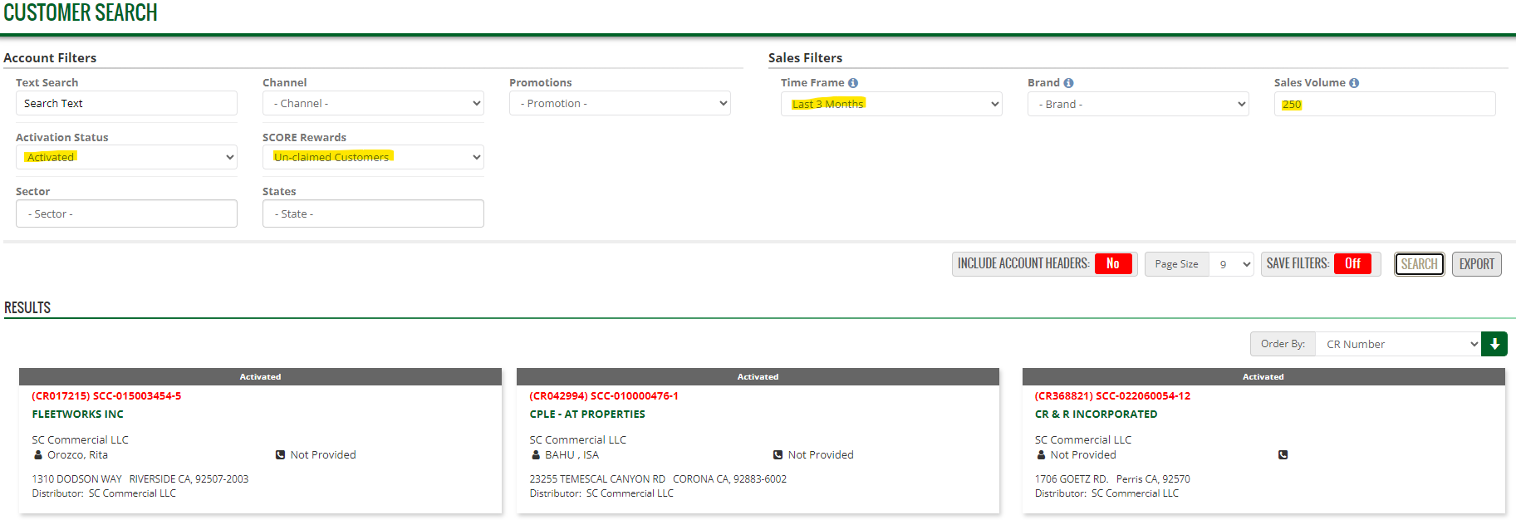
How to Claim Activated Accounts…continued
Castrol recommends DSRs select Activated in Status, Un-Claimed in SCORE Rewards, last 3 months in time frame, and enter 250 gallons to filter accounts with volume that will generate immediate points
    Otherwise run the search with no filters and look for accounts you can grow and earn points with for Castrol sales
Review and choose accounts from the results field and proceed to the next step
1
1
1
1
2
CR123456
Example Lube 1500
Pittsburgh Street
Distributor: XYZ
*Customer information removed for demonstration purposes

Slide 5
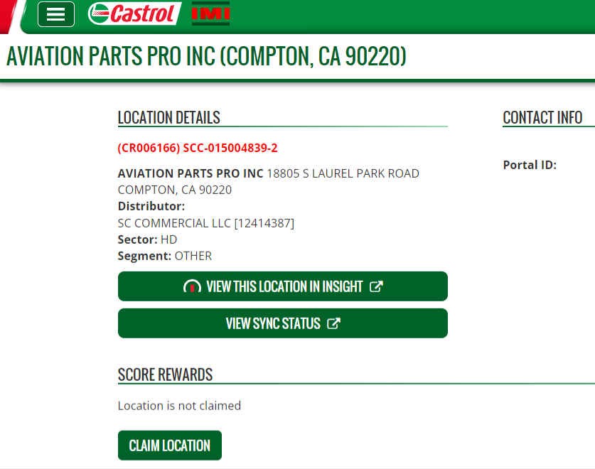
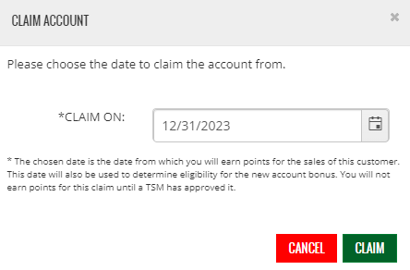
How to Claim Activated Accounts…finish
Select “Claim Location”
Select the date when claiming the Account – then click Claim to finish the process
Customer Name / Location info
CR123456
Example Lube 1500
Pittsburgh Street
Distributor: XYZ
2
1
*Customer information removed for demonstration purposes

Slide 6
How to Claim Accounts that are not activated
Not activated accounts are those that require confirmation of address, owner information, and other account details to support account management within Castrol programs.
Log into your SCORE Rewards dashboard (IMI) at: https://castrolstreetview.com
After logging in, click “Not Activated” to explore accounts you can claim for Castrol awards
Examples shown for reference

Slide 7
How to Claim Accounts that are not activated …continued
Castrol recommends DSRs select Not Activated in Status, Un-Claimed in SCORE Rewards, last 3 months in time frame, and enter 250 gallons to filter accounts with volume that will generate immediate points
    Otherwise run the search with no filters and look for accounts you can grow and earn points with for Castrol sales
Review and choose accounts from the results field and proceed to the next step
1
Not-Activated
1
1
1
2
CR123456
Example Lube 1500
Pittsburgh Street
Distributor: XYZ
*Customer information removed for demonstration purposes

Slide 8
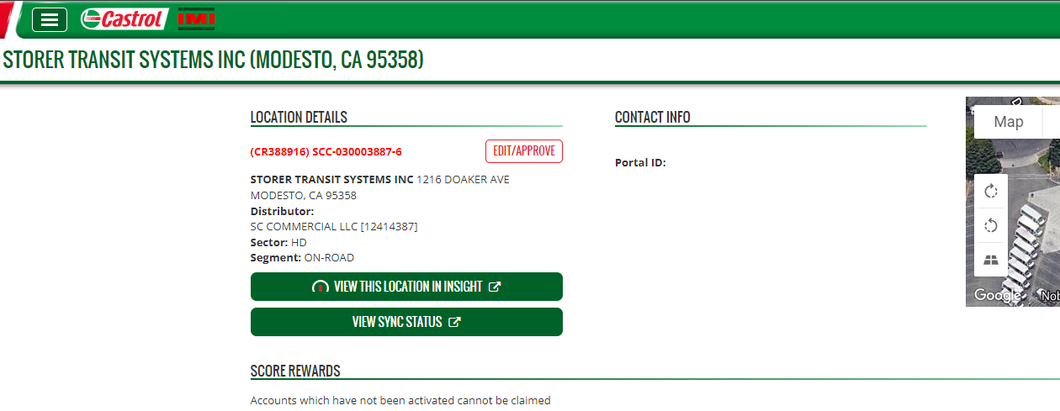
How to Claim Accounts that are not activated …continued
DSR should click Edit/Approve and proceed to the next sections for entering customer info
Customer Name / Location
CR123456
Example Lube 1500 Pittsburgh Street
Pittsburgh, PA 15222
Distributor: XYZ(123456789)
Sector: PCO
*Customer information removed for demonstration purposes

Slide 9
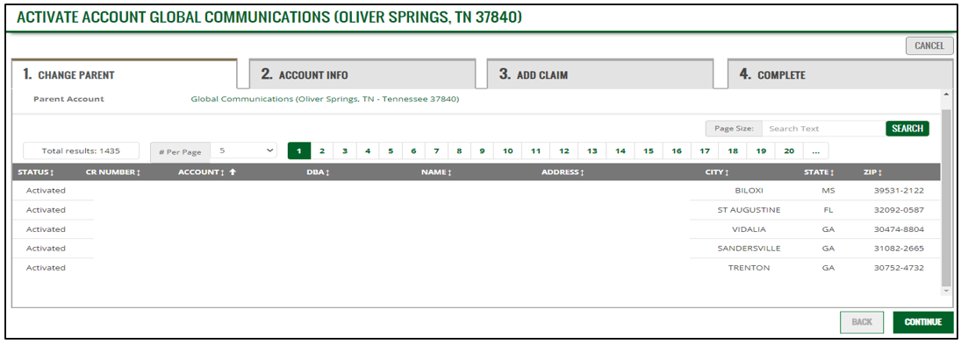
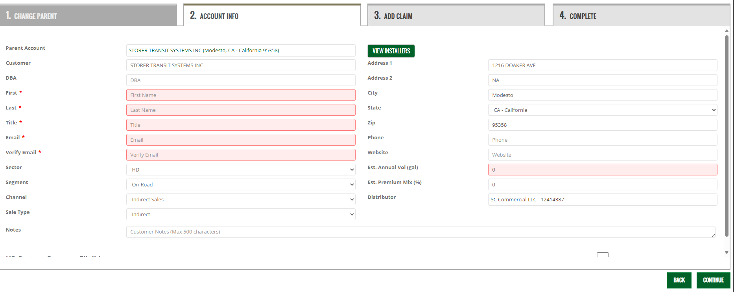
How to Claim Accounts that are not activated …continued
DSR must verify parent customer details and make changes as necessary, if no changes click continue
DSR must validate account data provided from Turfview, enter required* customer info, and estimated annual volume / estimated premium mix - then click continue
Customer Name / Location
Click cancel to stop the claim process at any time (if necessary)
1
ACCT INFORMATION
2
2
*Customer information removed for demonstration purposes

Slide 10
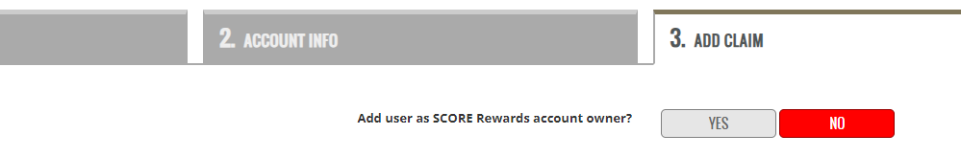
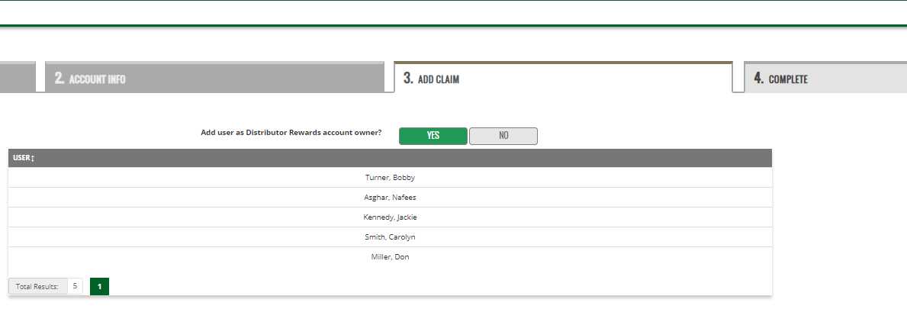
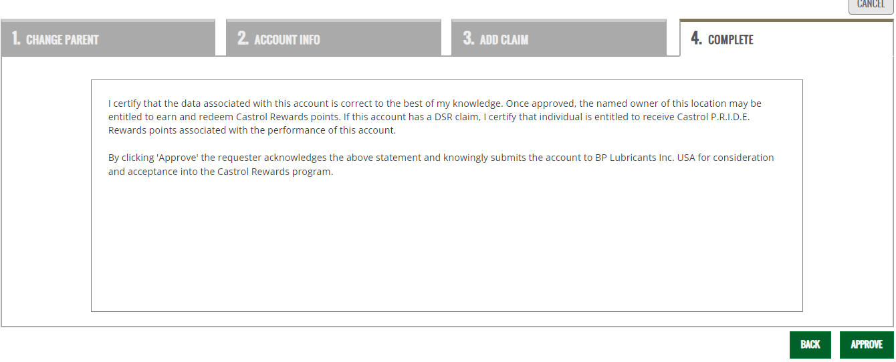
How to Claim Accounts that are not activated …finish
DSR must select “Yes” to link account with DSR SCORE Rewards account
DSR must choose their name from the list (example below) to claim the account under their name
DSR must review and certify data entered is correct, then click approve to finish
1
Sarah Mayer
Santa Claus
Jim Bay
2
*Customer information removed for demo purposes
3

Slide 11
How to Spend Points
Log into your SCORE Rewards dashboard (IMI) at: https://castrolstreetview.com
Click the current balance to access the merchandise, travel, entertainment, and gift card area
Examples shown for reference

Slide 12
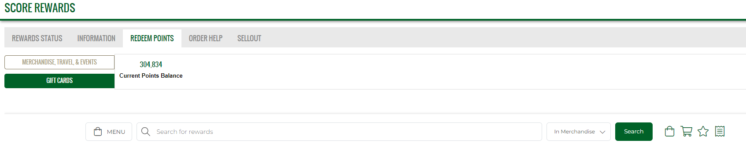
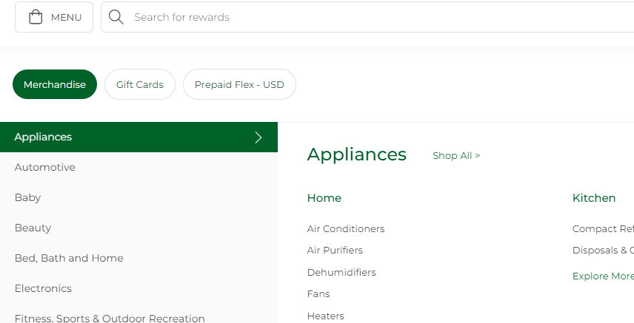
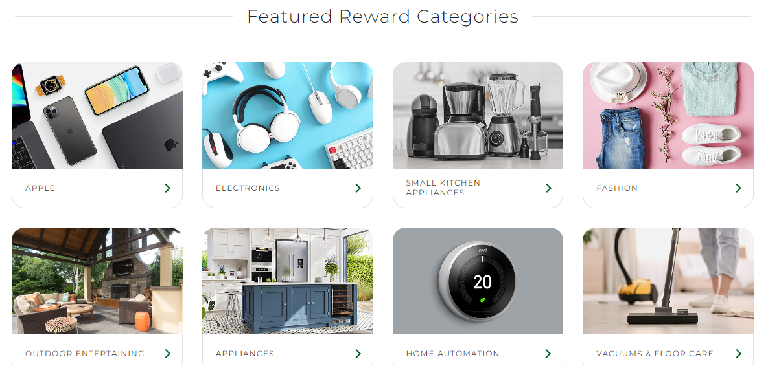
How to Spend Points … continued
Use the Menu to search through all merchandise categories for items to purchase with Castrol points
Search for specific merchandise in the Featured Reward Categories section
1
2

Slide 13
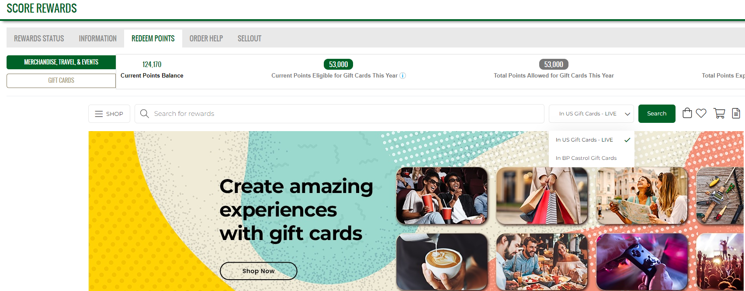
How to Spend Points on Gift Cards*
Choose Gift Cards on the left side of the Redeem points tab
Site tracks amount spent. Once limit is reached site blocks any other gift card purchases until January 1 of the following year when limits are replenished
Select US or BP/Castrol Gift Cards from the drop-down menu
    US gift cards can be redeemed from any vendors in the featured category section
    BP/Castrol gift cards can be redeemed for Castrol branded merchandise in the Castrol store
1
2
3
*Note: Per Castrol program guidelines gift card renewal limits are $1,000 annually.

Slide 14
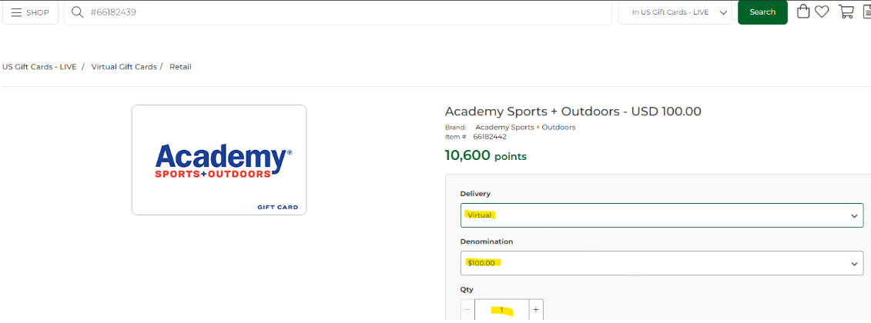
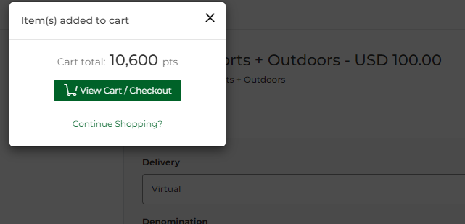
How to Spend Points on Gift Cards*
Select a merchant, virtual delivery, denomination, and quantity. Then click add to cart
Choose View Cart to review the order and enter your mailing address/shipping details
Follow the prompts to complete the order
    Watch for the virtual card to arrive by email
    If you experience issues and need assistance with your order, see slide 17 for support details
3
5
4
*Note: Per Castrol program guidelines gift card renewal limits are $1,000 annually.

Slide 15
Additional Information
Points:
No limit on points members can spend on merchandise, travel and events
Members have 30 days to spend points following resignation from company
Members will stop accruing points immediately after resignation
Point balances will be zeroed out after 30-day grace period
Order Issues:
Allow 24 hours to receive a reply for order support request
Returns are available if product is damaged, or the wrong item was shipped
Points will be refunded after returns have been received

Slide 16
Additional Information … continued
Gift Cards:
Purchases must comply with Castrol Corporate guidelines
No Authorization required for gift cards purchases up to $500
DOB must be supplied for gift card purchases between $500 and $1,000
Gift card site tracks amount spent. Once limit is reached site will block any further gift card purchases until limits are replenished on January 1 of the following year
Unspent points for gift cards do not carry over
Gift cards are ELECTRONIC, not a hard copy
Gift cards are issued via email (save the email) within 24 hours of placing order
Gift cards are NOT refundable for cash equivalent
Service fees included - some charges may vary

Slide 17
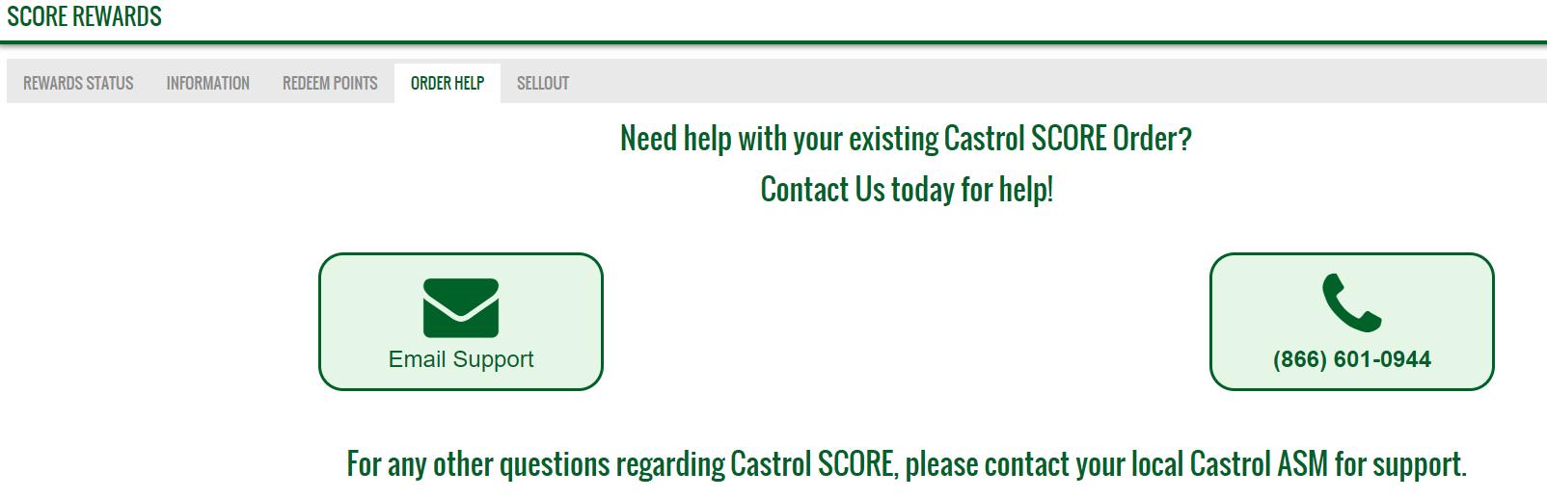
Order Support
Log into your SCORE Rewards dashboard (IMI) at: https://castrolstreetview.com
Click the current balance oval to access the Rewards Status, Information, Redeem Points, Order Help, and Sellout tabs
Examples shown for reference
3. Under the Order Help Tab choose Email or Phone Support for assistance with any order related issues
Examples shown for reference

Slide 18
Order Support … continued
Questions on the Castrol Distributor Rewards Program
contact your support team noted below
  Primary: Castrol Distributor Business Managers & Castrol Area Sales Managers
Thank you!

