Slide 1
Castrol Distributor Rewards
Sales Incentive Program Overview

Slide 2

What is SCORE Rewards
Castrol awards program where DSRs can earn points for signing new accounts and maintaining accounts that purchase Castrol
Points can be spent on over 100,000 items in the merchandise mart, exciting trips, entertainment experiences, and gift cards
Ex. new customer purchases (2) drums/month DSR earns 100,000-point signing bonus
DSRs receive ongoing points as long as customers are buying Castrol
Points accumulate for the life of the customer

Slide 3
SCORE Rewards for Distributor Sales Representatives
Program Highlights
Points DO NOT Expire
Points paid per Castrol gallons sold to customer + potential for New Account Bonuses
Points per gallon are based on Castrol product brand
3-Tier Structure Based on Annualized Gallons Sold:
“Platinum” (DSRs)
Maintain 75,000 gallons of existing volume or sign 15,000 gallons of new business annually
Earn additional 20% bonus for each award transmittal while maintaining volume thresholds
(ex. sell 100 gallons of EDGE and receive an additional 200 points)
“Gold” (DSRs)
Maintain more than 5,000 gallons of existing volume or sign at least 1,000 gallons of new business annually
“Silver” (DSRs)
Maintain less than 5,000 gallons of existing volume and sign less than 1,000 gallons of new business
Enter deactivation process and no longer earn awards if minimum gallons are not upheld over 90 days

Slide 4
Section Summary
Castrol Portal Registration
5-6
Castrol Score Rewards Registration
7-12
How to SCORE Rewards
13-15
Support / Assistance
17

Slide 5
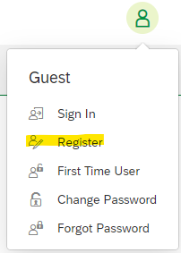
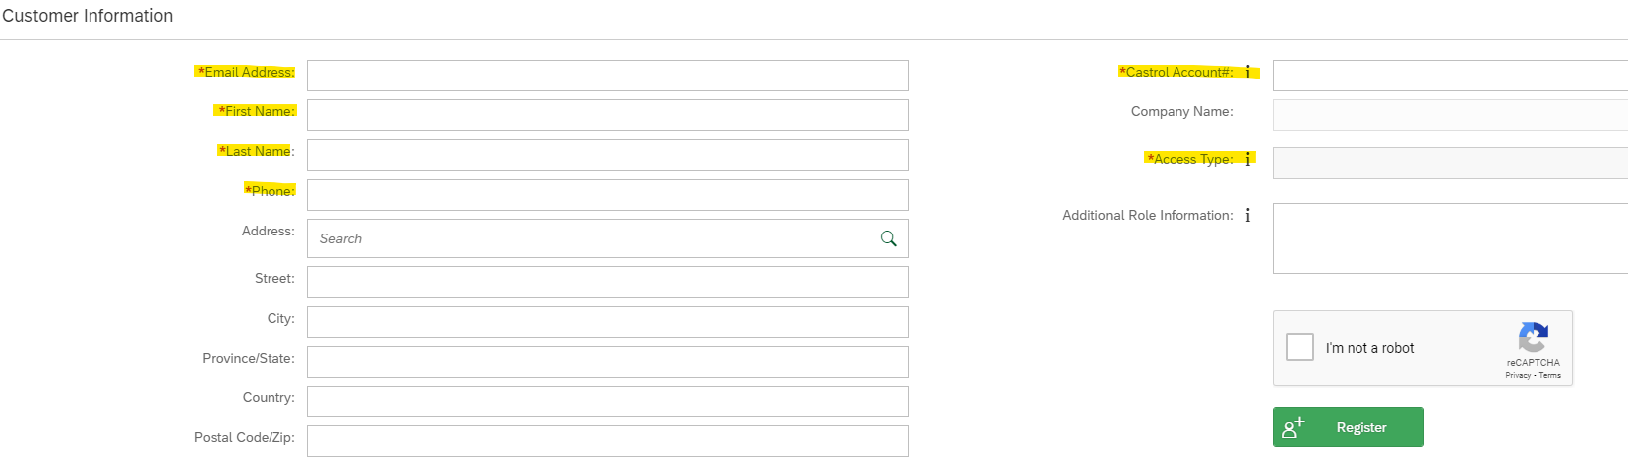
Castrol Portal Registration – only for new DSRs
Open a web browser and visit customerportal.castrol.com
Click on the profile image in the top right-hand corner and choose register
Enter your personal details, Castrol account #, and Access type in the required* fields
Check the I’m not a robot field
Review all information for accuracy and click “Register”
Watch for the email containing username *(save in a safe place for future reference)
2
3
Examples shown for reference

Slide 6
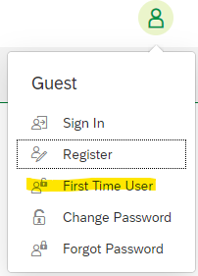
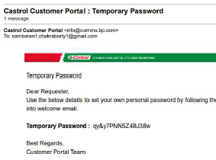
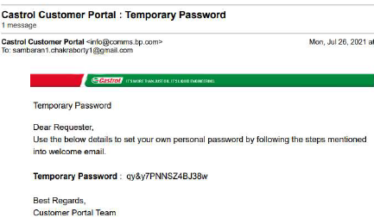
Castrol Portal Registration… continued
3. Review registration email containing username - save in a safe place for future reference
Watch for 2nd email containing temporary password - save for future reference
Go back to the portal and click first time user log in
Use temporary password from registration email to create permanent PW
Save UN and PW in a safe place for future reference
5
4
4
Examples shown for reference
Examples shown for reference

Slide 7
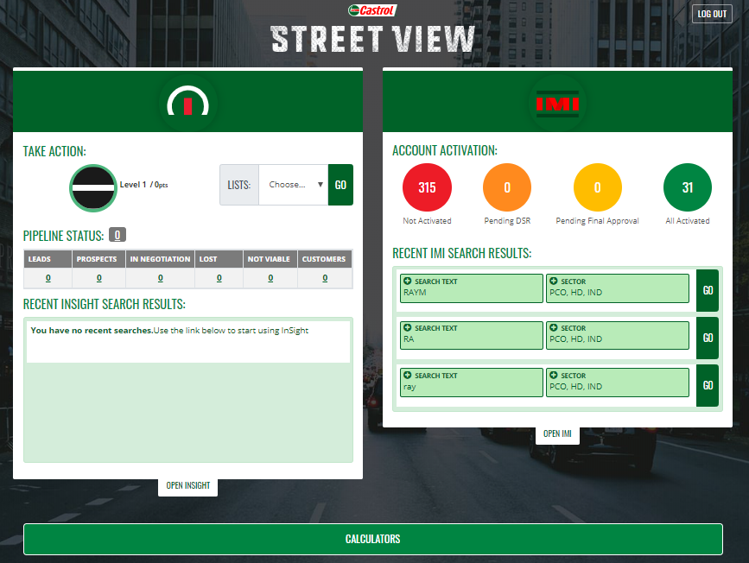

Castrol SCORE Rewards Registration
Open Castrol Streetview: https://castrolstreetview.com/sso/
Select “Open IMI”
Click Here

Slide 8
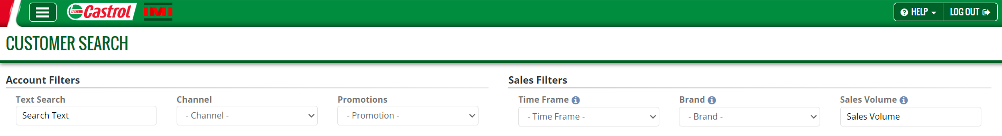
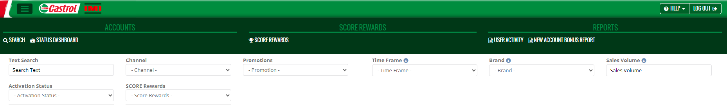
Castrol SCORE Rewards Registration… continued
Select the three horizontal bars in the top left-hand corner
Choose “Castrol SCORE”
Click Here
Click Here

Slide 9
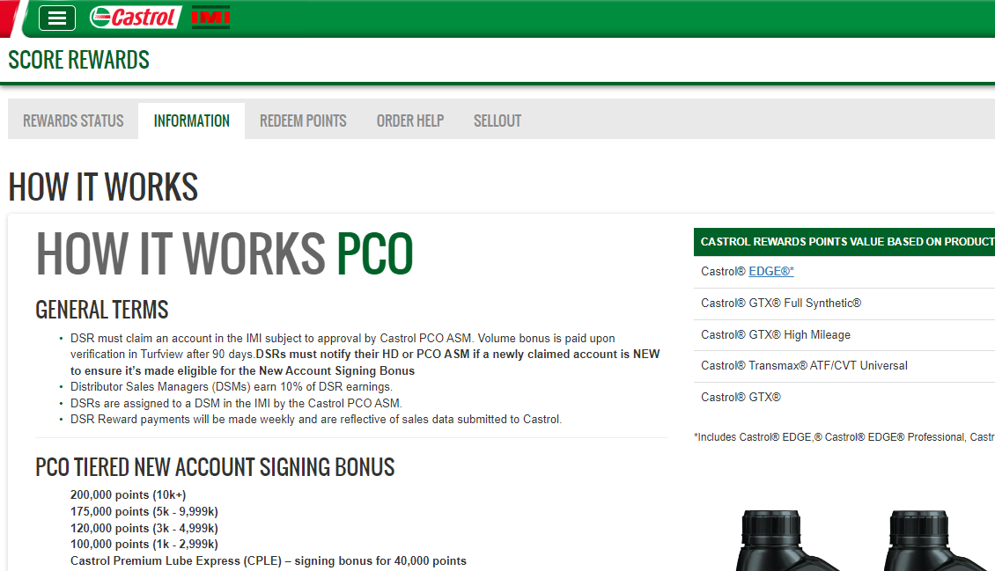
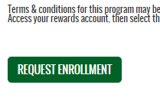
Castrol SCORE Rewards Registration… continued
Read through the How it Works sections
Scroll to the bottom, then select “Request Enrollment” to proceed

Slide 10
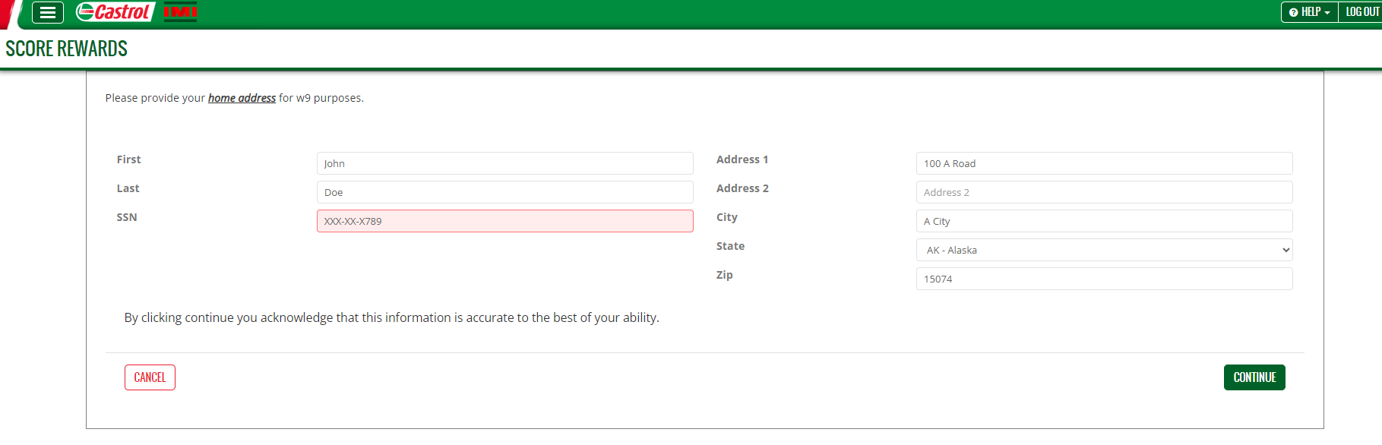
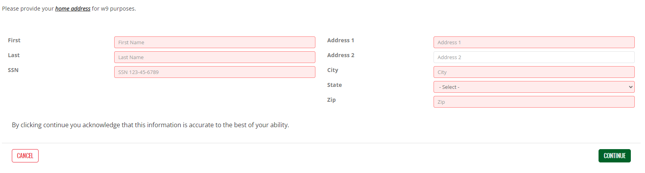
Castrol SCORE Rewards Registration… continued
Provide your home address info and SSN for W9 purposes.
Select “Continue” to proceed

Slide 11
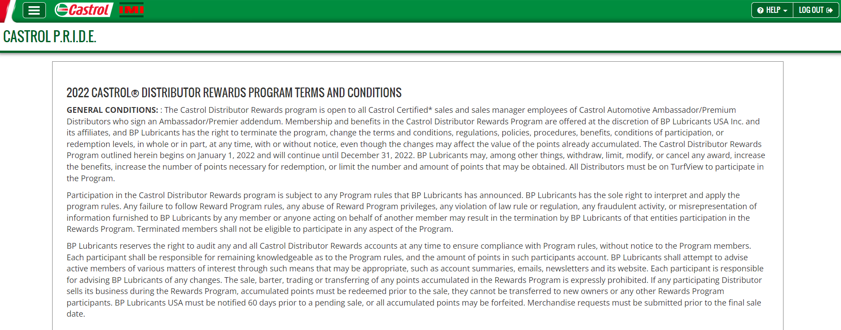

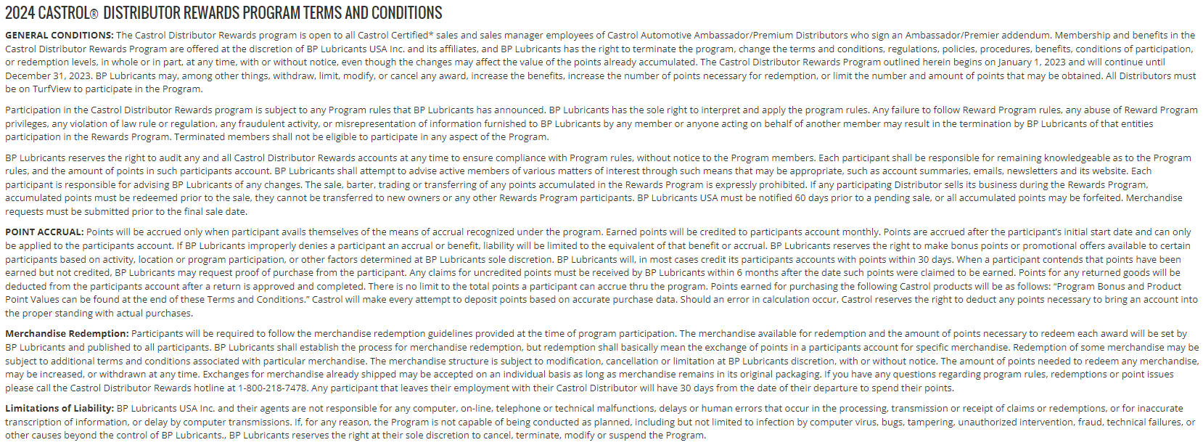
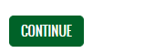
Castrol SCORE Rewards Registration… continued
Provide your home address info and SSN for W9 purposes.
Scroll to the bottom, then select “Continue” to proceed
Review Program Terms & Conditions

Slide 12
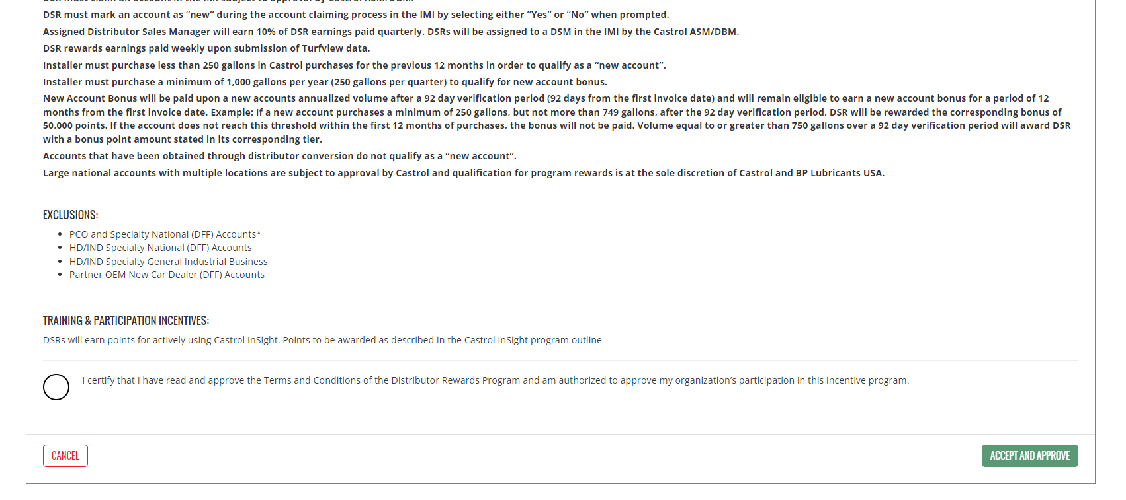
Castrol SCORE Rewards Registration… finish
Tick I certify and click “Accept and Approve” to complete the renewal

Slide 13
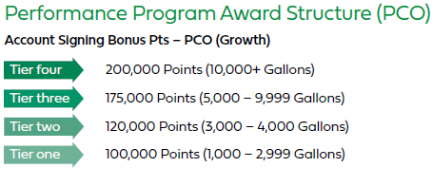
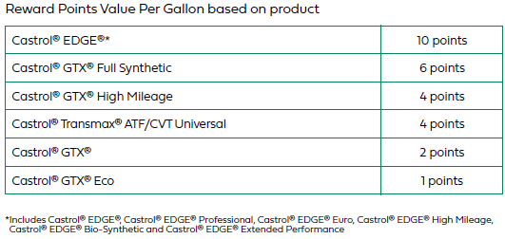
How to SCORE Rewards – Passenger Car Oil products
New accounts must purchase minimum annualized volume requirements*
Existing accounts pay out per gallon purchased based on the point structure shown*
*Images shown for reference – see program brochure for full details
Note: Points have 1% cash value - Example 100,000 = $1,000

Slide 14
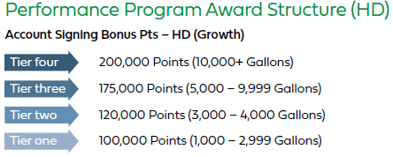
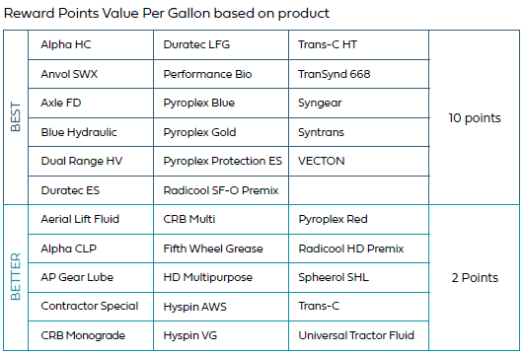
How to SCORE Rewards – Heavy Duty products
New accounts must purchase minimum annualized volume requirements*
Existing accounts pay out per gallon purchased based on the point structure shown*
*Images shown for reference – see program brochure for full details
Note: Points have 1% cash value - Example 100,000 = $1,000

Slide 15
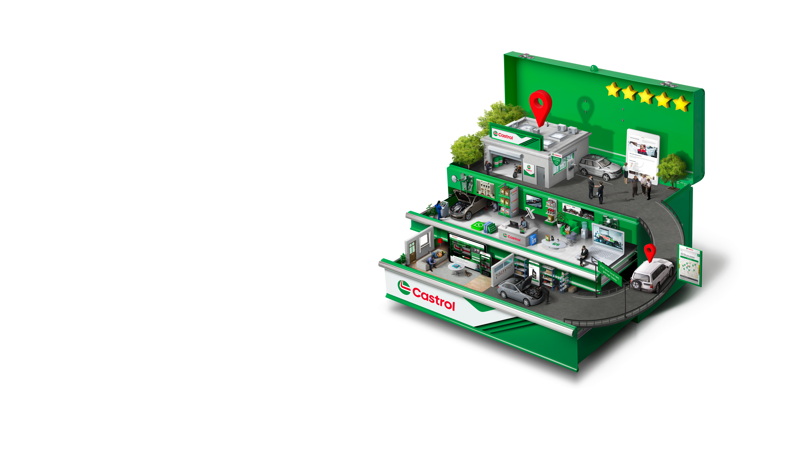
SCORE Rewards for Castrol Partner Program Shops – Additional Incentives
Any NEW Castrol Partner Program account activated and claimed by DSR with Turfview purchases between will get new account points + CPP BONUS payout
Important to Note:
Account has to be classified as appropriate CPP tier during IMI account activation
Account has to accept their CPP tier Eligibility Requirements in their SYNC account
DSR Reward examples below:
CPP Platinum Shop (7,500 gallons)
New Account Bonus = 175,000 SCORE Awards ($1,750)
CPP Platinum Shop Bonus = 40,000 SCORE Awards ($400)
1 CPP Platinum Shop = 215,000 Total SCORE Awards ($2,150)
CPP Gold Shops (2,000+ gallons)
New Account Bonus = 100,000 SCORE Awards ($1,000)
CPP Gold Shop Bonus = 20,000 SCORE Awards ($200)
1 CPP Gold Shop = 120,000 Total SCORE Awards ($1,200)
CPP Silver Shops (1,000 – 1,999 gallons)
New Account Bonus = 100,000 SCORE Awards ($1,000)
CPP Silver Shop Bonus = 10,000 SCORE Awards ($100)
1 CPP Silver Shop = 110,000 Total SCORE Awards ($1,100)
New account bonus paid 91 days after requirements and validation

Slide 16
Thank you!

